Slide 1
WG Communication
General Assembly, KU Leuven, April 12th, 2024 – Klaus Rümmele

Slide 2
Latest Activities
One meeting online on March 6th, 2024, and one in-person meeting on April 10th, 2024
Main discussions
Use and production of testimonials
Good practice – videos on the spot
Contact to communication experts at the member universities
Participants – Wieland Craps, Jelle De Borger (KU Leuven), Laurent Delannay (UCL), Maria/Meriu Lopez (UPC), Klaus Rümmele (KIT), Jos Vander Sloten (KU Leuven)

Slide 3
Testimonials „Meet me in CLUSTER“
Guideline Draft further developed
Objectives and target groups
Topics
Opportunities for production
Dissemination
Roles
„About you“-information and questions
Additional facts
Multimedia requests
Style
Technical requirements

Slide 4
Involving Communication Experts
Setting up a mailing list
Invitation to an online meeting
Offer to join the WG Communication
Suggesting scientists or students to be presented in a video testimonial
Experts producing the video

Slide 5
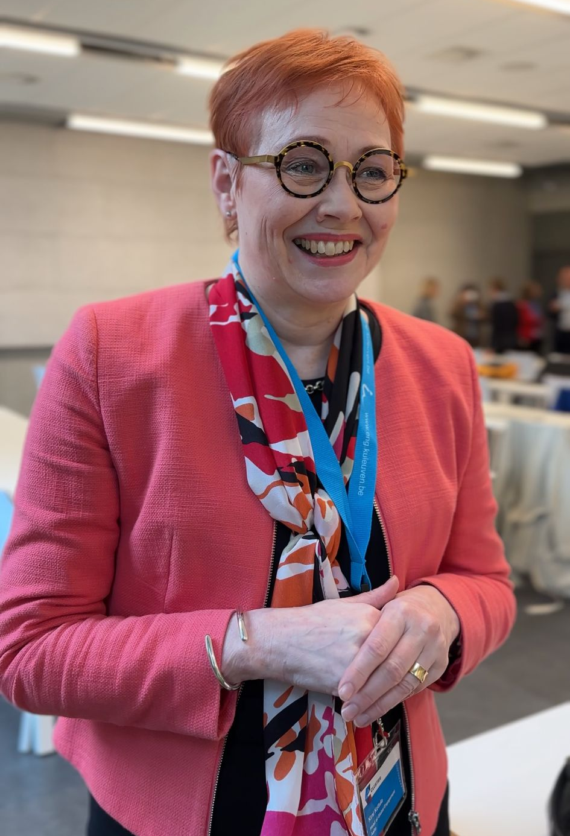
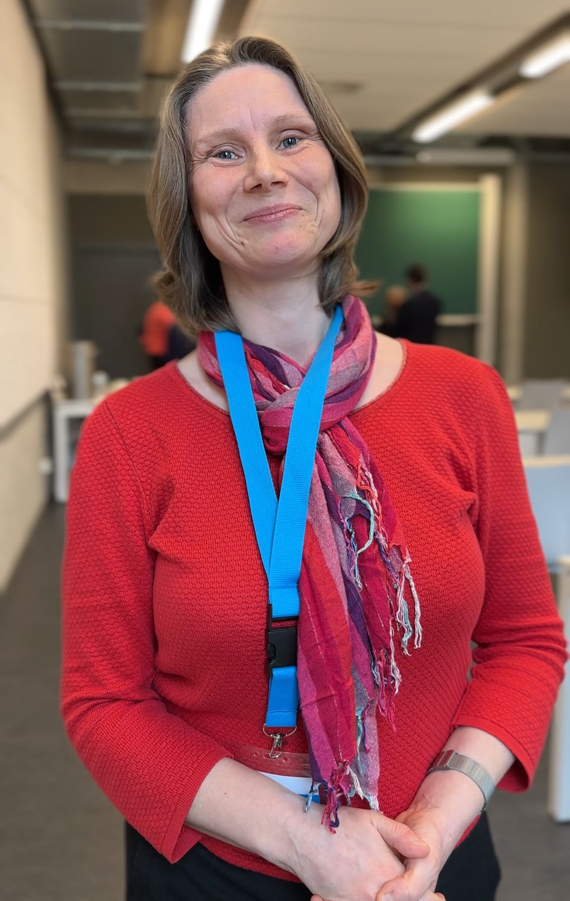
Good practice – Videos on the Spot
Opportunities
Steering Committee Meetings and General Assemblies
Events like the BlP Staff week, April 15th to 19th, 2024
Mix of short statements with personal and institutional focus
Flashlight on the experience and value of taking part in CLUSTER activities
Appetizer for more elaborated testimonials

