Slide 1
Working Group – CLUSTER & Africa Laurens Rademakers
General Assembly – Leuven
April 12, 2024

Slide 2
1. Rationale and relevance
WHY FOCUS ON AFRICA?
Common challenges based on proximities between Europe & Africa
Complex challenges require cooperation; critical role of science, technology, engineering
Build a community of (academic) stakeholders, enabling environment for new generation of engineers
Reciprocity: learn from each other, strengthen each other’s capacities, joint responsibility – new concepts driving equitable cooperation
Increased attention for cooperation with Africa amongst funding agencies (European Commission)
→ Value-driven Mission statement

Slide 3
2. Achievements
ACTION PLAN
Short term – small, fast, flexible, steppingstones can grow into larger initiatives (also research)
Build trust first, genuine partnership later
Blended intensive program (not yet)
Inclusive & green principles; innovation in virtual learning
African partners highly interested
Proposal: BIPs with involvement of African students: enrichting experience for all
Erasmus+ project (KTH Royal Institute of Technology) (submitted)
Challenge-driven engineering education to solve sustainable development challenges
Large multinational consortium
Strict timeline
Seed fund (not yet)
Event on student entrepreneurship at KU Leuven (2023): participation of young African entrepreneurs
Explore nature of innovation ecosystems (linkages between research – entrepreneurship in African context)

Slide 4
2. Achievements
Erasmus+ project
Successfully submitted – results in July
E+ CBHE, strand 2, multinational project
• General objective:
to build and strengthen the capacity for implementing and mainstreaming ‘Transformation-Driving Education’ (TDE) which takes up concepts of PBL, CBL, and CDE, and relates them to recent approaches of transformative learning.

Slide 5
2. Achievements
Full partners:
KTH, Sweden (lead applicant)
Aalto University, Finland
Eindhoven University of Technology, Netherlands
University of Dar es Salaam, Tanzania
University of Dodoma, Tanzania
University of Rwanda, Rwanda
Rwanda Polytechnic, Rwanda
University of Kinshasa, DRC
Catholic University of Bukavu, DRC
Strathmore University, Kenya
University of Nairobi, Kenya
Associated partner:
African Network for Engineering Education Research (EERN-Africa)

Slide 6
3. Evolution European funding
increasing access to quality education, skills, research, innovation, health and social rights;
creating a knowledge society and economy
scale up EU-Africa academic & scientific coop.
TVET & skills development
mobility of students, teachers, trainers, and researchers;
capacity building; quality training teachers; development of R&I capacities; interaction education, science, technology and innovation for improved learning
also digital transformation partnership
Notes:
! Research and innovation voor het eerst als onderdeel/voorwaarde voor groei en jobs

Slide 7
3. Evolution European funding
2021: ‘Global Gateway Africa’ (strategic investments in infrastructure)
Priorities: digital, climate & energy, transport, health, and education & research
2022: AU – EU Summit: Africa-EU Science, Technology and Innovation (STI) Initiative: Joint AU-EU Innovation Agenda
Priorities: long term scientific and innovation cooperation between European & African universities; circulation of talent; shared top-infrastructure; joint Centres of Excellence

Slide 8
3. Evolution European funding
AU – EU Innovation Agenda (June 2023)
Several EU instruments pooled for the roll-out and implementation of the AU-EU Innovation Agenda
Second Work Programme of Horizon Europe (2023-2024) – ‘Africa Initiative’ (continuation?)
Global Gateway Africa — Europe Investment Package
Neighbourhood. Development and International Cooperation Instrument (NDICI) — 'Global Europe’ (E+ instruments)
Other possible options being explored
Notes:
Source: (REF 161600) A presentation on the interface between Horizon Europe and NDIC/Global Europe
Speaker Nienke Buisman; European Commission, Directorate-General Research & Innovation, Head of Unit International Cooperation Policy

Slide 9
3. Evolution European funding
Individual researchers:
ARISE programme strengthened:
1 PI + 4 PhD + 8 MA (total: 585 young researchers)
Large grant for post-docs, institutional strengthening of departments, mobilities to Europe
Simultaneous investments in top infrastructure
Alignment with Centres of Excellence
Also looking at mid-career and senior researchers, via international mobility (encouraging brain circulation)

Slide 10
3. Evolution European funding
Institutional cooperation: AU-EU Centres of Excellence
‘Integrating’ universities in Europe and Africa
Creation of joint doctoral schools
Increasing mobility of researchers and staff; creating a strong cross-continental network of expertise
CoE linked with local, national and regional governments; cooperation with social and private sectors; ‘uptake’ of science for policy
Concentrating infrastructure investments in those centra
→ Highly relevant for CLUSTER

Slide 11
3. Evolution European funding
Infrastructure investments
Lack of excellent labs, materials, buildings, infrastructures
Creating concentrated ‘hubs’ with excellent material resources (CoE’s)
Leveraging different financial resources: EU, AU, governments, private sector, philanthropy
Need for a platform: avoid duplication (linking innovation ecosystems)

Slide 12
3. Evolution European funding

Slide 13
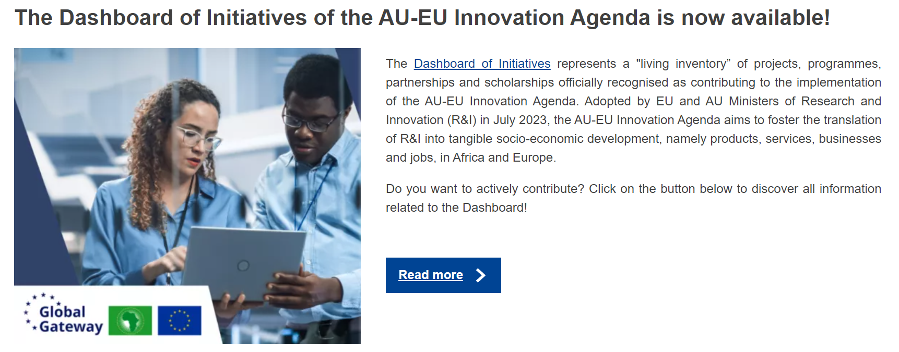
3. Evolution European funding

Slide 14
3. Evolution European funding
Align with CLUSTER activities on Entrepreneurship

Slide 15
4. Evaluation and recommendations
Relevance of the WG for CLUSTER
Focus still very relevant, increasing opportunities
Coordination and leadership
Stronger coordination needed and delegation of tasks; engaging more expertise amongst members
Interaction with other WGs
Strengthening interactions to explore synergies (e.g. Entrepreneurship Education Ecosystems in Engineering and Technology (E4T) with AU-EU Innovation Agenda)
GAST: keep track of evolution in European funding
Partnerships and networking in Africa
Effective method (gradual build-up, based on trusted partners), project-based strategy

