Slide 1


SEEEP High Level Doctoral Schools
Prof. David Smeulders
Eindhoven University of Technology
Cluster GA, KU Leuven, 12 April 2024

Slide 2

Doctoral summer schools
  The Doctoral Schools are organized within the Sino-EU Engineering Education Platform and SESE Doctoral Programs for Sustainability Engineering.
  Bring professors & PhD candidates from the highest level together to come up with solutions to the grant societal challenges, such as sustainable energy, energy transitions, health or active aging.
  Big schools, lasting for two weeks, and consisting of multiple universities from China and Europe. Aim is to have 10-18 professors from European & Chinese partners, teaching up to 60 PhD’s from both sides
  Challenges are formulated and addressed/solved by multidisciplinary and multinational teams of students
  Organized once a year, alternating between China and Europe
  Organized twice online /on-campus during pandemic
SEEEP

Slide 3
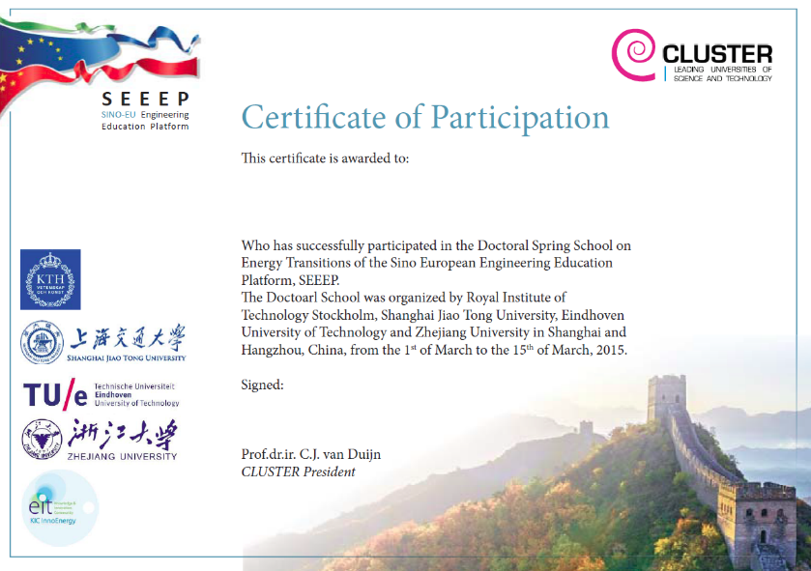
Certificate of Participation

Slide 4
Historical Overview
Shanghai & Hangzhou
  Energy Transitions: China CO2 Neutral
Stockholm & Eindhoven
  Energy Transitions: EU CO2 Neutral
Shanghai & Hangzhou
  Energy Systems in Cities
Stockholm & Eindhoven
  Energy Storage & Flexibility
Shanghai & Hangzhou
  Affordable Energy Transition
2021 KTH & TU/e on-line
Pathways towards net zero
2022 KTH & TU/e on-line and on-campus for EU students
Resilient Energy Systems
2023 Shanghai & Hangzhou
The Role of Fossil Fuels in the Energy Transition
2024 KTH & TU/e
Energy System Transformation: the impact of electrification

Slide 5
Historical Overview
Year | Location | PhDs China | PhDs EU | Tot. PhDs | Professors
2015 | Shanghai & Hangzhou | 33 | 24 | 57 | 22
2016 | Stockholm & Eindhoven | 31 | 25 | 56 | 31
2017 | Shanghai & Hangzhou | 24 | 17 | 41 | 20
2018 | Stockholm & Eindhoven | 30 | 24 | 54 | 15
2019 | Shanghai & Hangzhou | 40 | 8 | 48 | 10
2021 | KTH & TU/e on-line | 37 | 21 | 58 | 22
2022 | KTH & TU/e | 46 (online) | 17 (on campus) | 63 | 21
2023 | Shanghai & Hangzhou | 41 | 23 | 64 | 12

Slide 6
Edition 2023

Slide 7
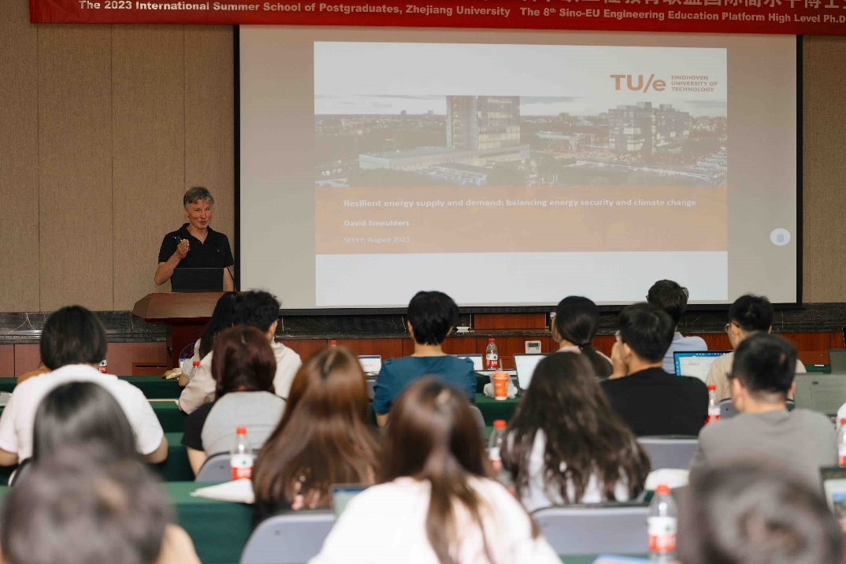
Edition 2023

Slide 8
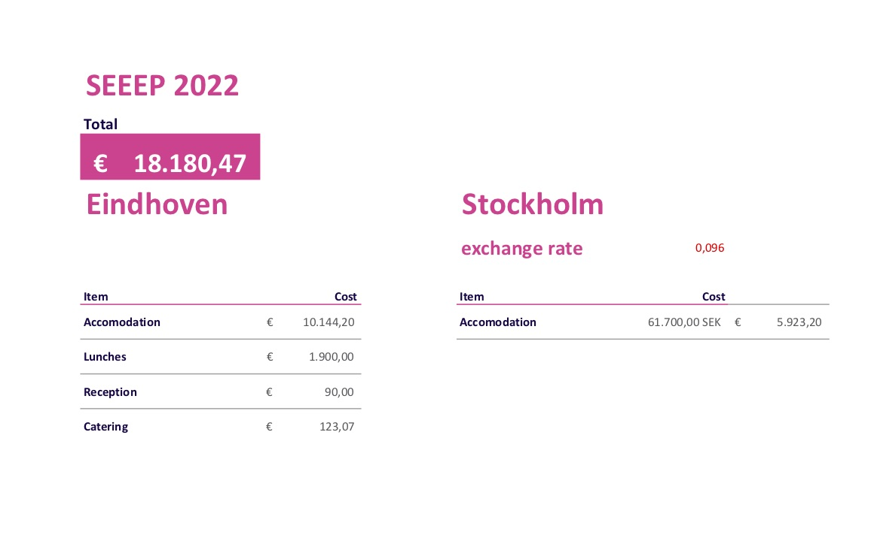
Finances 2022
Proposed CLUSTER subsidy: 1 k€ per CLUSTER student

Slide 9
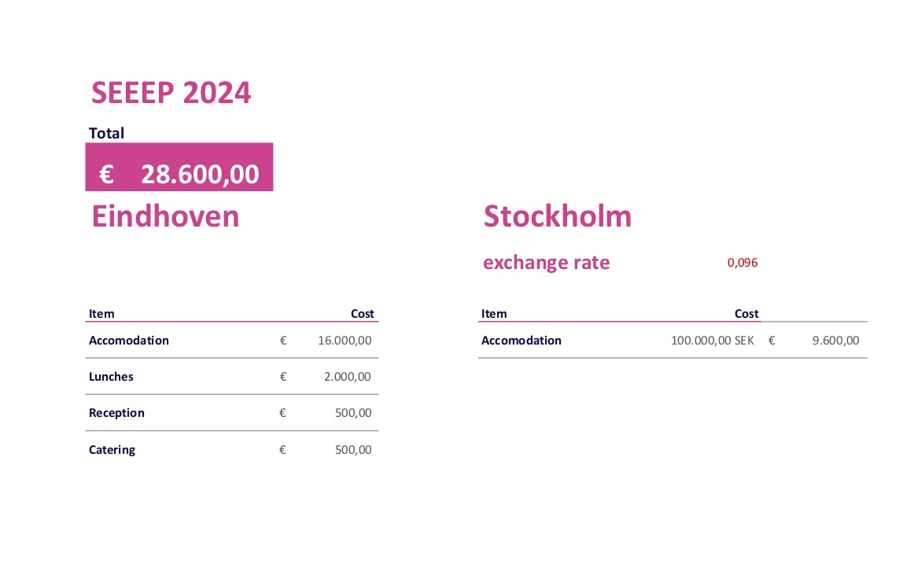
Finances 2024
Proposed CLUSTER subsidy: 1 k€ per CLUSTER student

Slide 10
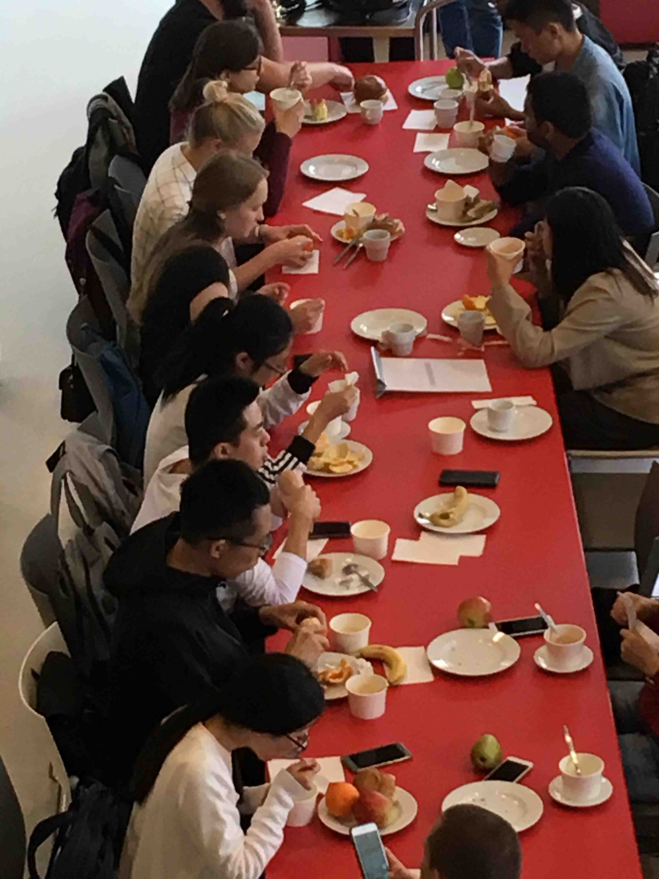
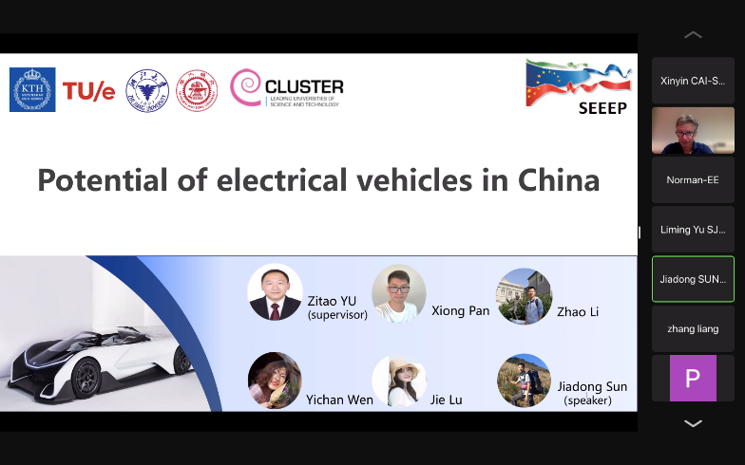
Conclusions
Working together – succesfull projects
Mutual understanding– successfull programmes
Friendship – lasting relations

