Slide 1
Working Group – CLUSTER & Africa Laurens Rademakers
Steering Committee – Leuven
April 10, 2024

Slide 2
Agenda
1. Tour de table
2. Rationale for cooperation with Africa within CLUSTER and recap of previous SC’s
3. Update: concrete initiatives (E+ CBHE)
4. Evolution of European funding for cooperation with Africa
5. Evaluation of the Working Group’s activities & recommendations
6. AOB

Slide 3
Agenda
1. Tour de table
2. Rationale for cooperation with Africa within CLUSTER and recap of previous SC’s
3. Update: concrete initiatives (E+ CBHE)
4. Evolution of European funding for cooperation with Africa
5. Evaluation of the Working Group’s activities & recommendations
6. AOB

Slide 4
Agenda
1. Tour de table
2. Rationale for cooperation with Africa within CLUSTER and recap of previous SC’s
3. Update: concrete initiatives (E+ CBHE)
4. Evolution of European funding for cooperation with Africa
5. Evaluation of the Working Group’s activities & recommendations
6. AOB

Slide 5
2. Rationale and recap
WHY FOCUS ON AFRICA?
Common challenges based on proximities between Europe & Africa
Complex challenges require cooperation; critical role of science, technology, engineering
Build a community of (academic) stakeholders
Reciprocity: learn from each other, strengthen each other’s capacities, joint responsibility – new concepts driving equitable cooperation
Increased attention for cooperation with Africa (European Commission)

Slide 6
2. Rationale and recap
Mission statement - WHAT?
Deploy resources in education, research, service to society
Co-create forward-looking agenda in these fields
Sustainable & ‘symmetric partnership’, open dialogue, relationship based on reciprocity, added value for all partners
CLUSTER values: cooperation aims for multidisciplinarity, inclusiveness, diversity, transparency and joint responsibility
Will be enriching for all partners and stakeholders

Slide 7
2. Rationale and recap
Mission statement - HOW?
Research:
set agenda together
tap growing number of opportunities (e.g. E+, Africa Initiative, AU-EU Innovation agenda)
go beyond project funding; sustainable relation (e.g. support doctoral schools)
Education:
Learn from each other; exchange diversity of perspectives on role of STI
Student and staff mobility between Africa and Europe, joint programs, virtual exchanges
Service to society:
Involve (non-academic) stakeholders working in ‘innovation ecosystems’
Jointly build experience in strengthening these ecosystems

Slide 8
2. Rationale and recap
ACTION PLAN
Short term – small, fast, flexible, steppingstones can grow into larger initiatives (also research)
Build trust first, genuine partnership later
Blended intensive program (not yet)
Inclusive & green principles; innovation in virtual learning
African partners highly interested
Proposal: BIPs with involvement of African students: enrichting experience for all
Erasmus+ project (KTH Royal Institute of Technology) (submitted)
Challenge-driven engineering education to solve sustainable development challenges
KU Leuven willing to lead; KTH partner; others invited
Strict timeline
Seed fund (not yet)
Event on student entrepreneurship at KU Leuven (2023): participation of young African entrepreneurs
Explore nature of innovation ecosystems (linkages between research – entrepreneurship in African context)

Slide 9
2. Rationale and recap
Steering committee (March 2023): Polytechnique Montréal
-focus on E+ CBHE project
-spinoffs from this project
From other WGs:
-E4T program (Entrepreneurship Education Ecosystems in Engineering and Technology) – potential to branch out to African innovation and entrepreneurial ecosystems?

Slide 10
2. Rationale and recap
Steering committee (September 2023): Aalto University
-focus on E+ CBHE project
-identifying networks in Africa to cooperate with (gradually, first via individual strategic partners)
-long term: African partners as ‘associated members’ of CLUSTER
From other WGs:
-BIP potential for cooperation with African partners
-positioning of CLUSTER vis à vis European University Alliances (some of which cooperate with Africa) (any update?)

Slide 11
Agenda
1. Tour de table
2. Rationale for cooperation with Africa within CLUSTER and recap of previous SC’s
3. Update: concrete initiatives (E+ CBHE)
4. Evolution of European funding for cooperation with Africa
5. Evaluation of the Working Group’s activities & recommendations
6. AOB

Slide 12
3. Update concrete initiatives (E+ CBHE)
• Successfully submitted – results in July
E+ CBHE, strand 2, multinational project
• General objective:
to build and strengthen the capacity for implementing and mainstreaming ‘Transformation-Driving Education’ (TDE) which takes up concepts of PBL, CBL, and CDE, and relates them to recent approaches of transformative learning.

Slide 13
3. Update concrete initiatives (E+ CBHE)
Full partners:
KTH, Sweden (lead applicant)
Aalto University, Finland
Eindhoven University of Technology, Netherlands
University of Dar es Salaam, Tanzania
University of Dodoma, Tanzania
University of Rwanda, Rwanda
Rwanda Polytechnic, Rwanda
University of Kinshasa, DRC
Catholic University of Bukavu, DRC
Strathmore University, Kenya
University of Nairobi, Kenya
Associated partner:
African Network for Engineering Education Research (EERN-Africa)

Slide 14
Agenda
1. Tour de table
2. Rationale for cooperation with Africa within CLUSTER and recap of previous SC’s
3. Update: concrete initiatives (E+ CBHE)
4. Evolution of European funding for cooperation with Africa
5. Evaluation of the Working Group’s activities & recommendations
6. AOB

Slide 15
4. Evolution European funding
increasing access to quality education, skills, research, innovation, health and social rights;
creating a knowledge society and economy
scale up EU-Africa academic & scientific coop.
TVET & skills development
mobility of students, teachers, trainers, and researchers;
capacity building; quality training teachers; development of R&I capacities; interaction education, science, technology and innovation for improved learning
also digital transformation partnership
Notes:
! Research and innovation voor het eerst als onderdeel/voorwaarde voor groei en jobs

Slide 16
4. Evolution European funding
AU-EU Summit, 17-18/02/2022
aiming to launch the Africa-Europe Investment Package
global challenges - climate change - current health crisis
tools & solutions to promote stability and security through a renewed peace and security architecture
aiming to have a joint declaration on a joint vision for 2030 adopted by the participants
thematic roundtables
growth financing
health systems and vaccine production
agriculture and sustainable development
education, culture and vocational training, migration and mobility
private sector support and economic integration
peace, security and governance
climate change and energy transition, digital and transport [connectivity and infrastructure]

Slide 17
4. Evolution European funding
AU – EU Innovation Agenda
Several EU instruments envisaged for the roll-out and implementation of the AU-EU Innovation Agenda
Second Work Programme of Horizon Europe (2023-2024) – continuation?
Global Gateway Africa — Europe Investment Package
Neighbourhood. Development and International Cooperation Instrument (NDICI) — 'Global Europe'
Other possible options being explored
Notes:
Source: (REF 161600) A presentation on the interface between Horizon Europe and NDIC/Global Europe
Speaker Nienke Buisman; European Commission, Directorate-General Research & Innovation, Head of Unit International Cooperation Policy

Slide 18
4. Evolution European funding
2021: ‘Global Gateway’ (strategic investments in infrastructure)
Priorities: digital, climate & energy, transport, health, and education & research
2022: AU – EU Summit: Africa-EU Science, Technology and Innovation (STI) Initiative: Joint AU-EU Innovation Agenda
Priorities: long term scientific and innovation cooperation between European & African universities; circulation of talent; shared top-infrastructure; joint Centres of Excellence

Slide 19
4. Evolution European funding
Earmarking existing sources:
Horizon Europe’s Africa Initiative
Erasmus+: budget increase 6% to 28%
Global Europe/NDICI instrument: Intra-Africa Academic Mobility Scheme; African Research Initiative for Scientific Excellence (ARISE)
June 2023: final AU-EU Innovation Agenda

Slide 20
4. Evolution European funding
Synergies between different European instruments:
EU’s Global Europe/NDICI instrument - AU’s Education, Science, Technology, and Innovation Department resources
EU DG’s: INTPA – RTD –EAC
National and private financial resources in Europa and Africa
‘Team Europe’ approach

Slide 21
4. Evolution European funding
1. Individual researchers:
ARISE programme strengthened:
1 PI + 4 PhD + 8 MA (total: 585 young researchers)
Large grant for post-docs, institutional strengthening of departments, mobilities to Europe
Simultaneous investments in top infrastructure
Alignment with Centres of Excellence
Also looking at mid-career and senior researchers, via international mobility (encouraging brain circulation)

Slide 22
4. Evolution European funding
2. Institutional cooperation: AU-EU Centres of Excellence
‘Integrating’ universities in Europe and Africa
Creation of joint doctoral schools
Increasing mobility of researchers and staff; creating a strong cross-continental network of expertise
CoE linked with local, national and regional governments; cooperation with social and private sectors; ‘uptake’ of science for policy
Concentrating infrastructure investments in those centra

Slide 23
4. Evolution European funding
3. Infrastructure investments
Lack of excellent labs, materials, buildings, infrastructures
Creating concentrated ‘hubs’ with excellent material resources (CoE’s)
Leveraging different financial resources: EU, AU, governments, private sector, philanthropy
Need for a platform: avoid duplication (linking innovation ecosystems)

Slide 24
4. Evolution European funding

Slide 25
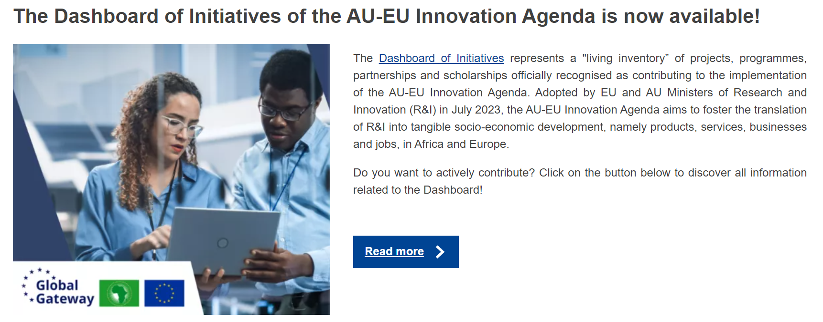
4. Evolution European funding

Slide 26
4. Evolution European funding

Slide 27
4. Evolution European funding

Slide 28
Agenda
1. Tour de table
2. Rationale for cooperation with Africa within CLUSTER and recap of previous SC’s
3. Update: concrete initiatives (E+ CBHE)
4. Evolution of European funding for cooperation with Africa
5. Evaluation of the Working Group’s activities & recommendations
6. AOB

Slide 29
5. Evaluation and recommendations
Relevance of the WG for CLUSTER
Coordination and leadership
Interaction with other WGs
Partnerships
Tangible outputs
Recommendations

Slide 30
6. Any other business

Slide 31
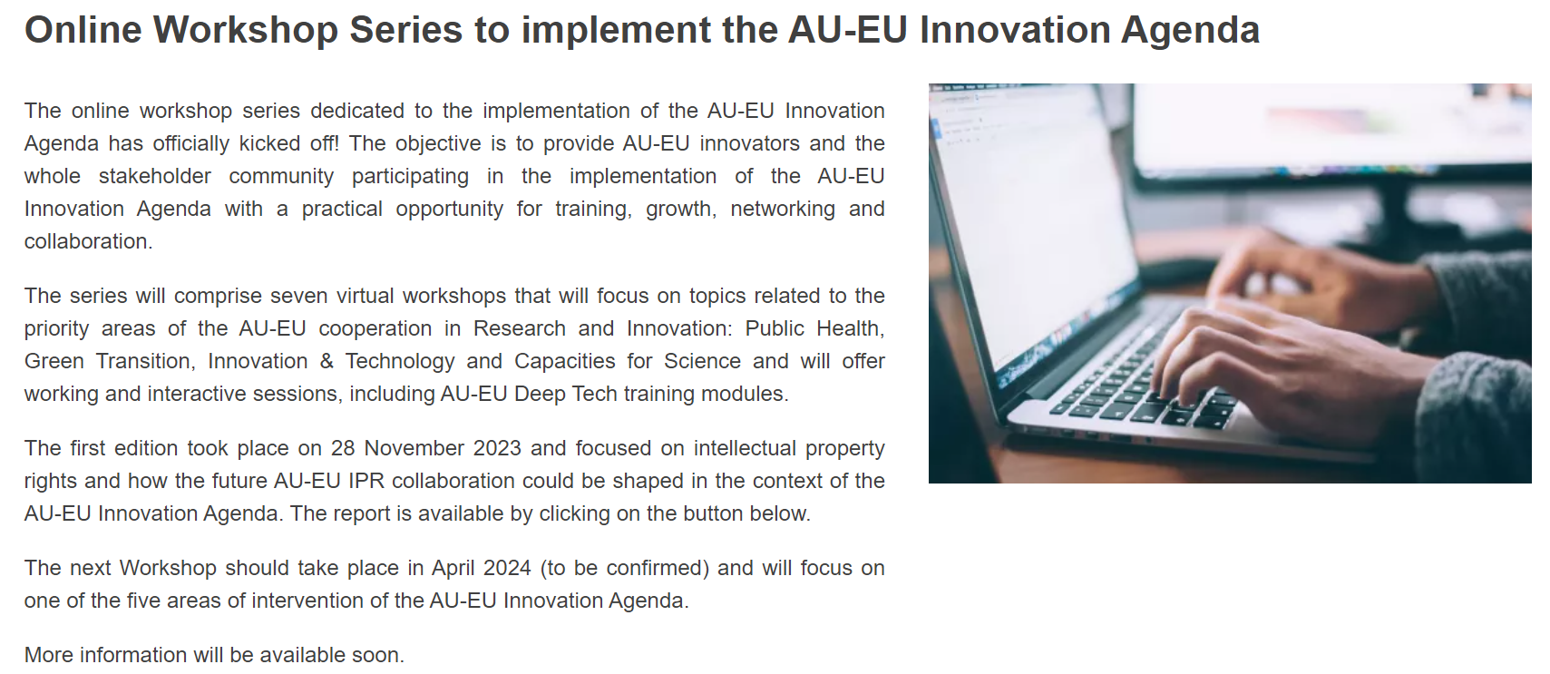
6. Any other business

