Slide 1
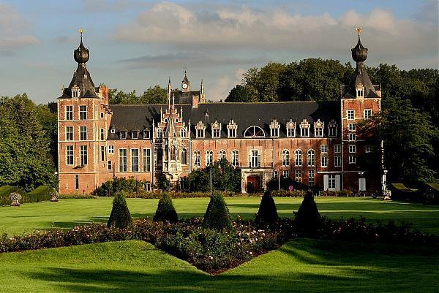
CLUSTER 2024 GENERAL ASSEMBLY – STEERING COMMITTEE APRIL 10-12, 2024 Leuven
WG Entrepreneurship

Slide 2
Erasmus+ project
Acronym: ChallengED
Empowering Innovation, Environmental action, and Civic Engagement through Challenge-Based Entrepreneurship Education
Some facts
3 year project
Starting (if granted!) 1 October 2024
Partners
KU Leuven (coördinator)
TU/e
KTH
UPC
Polito Torino

Slide 3
ChallengED: EU priorities targeted
Supporting innovation and entrepreneurial skills of students
Common values, civic engagement and participation
Environment and fight against climate change

Slide 4
ChallengED: objectives
The objective of ChallengED is to develop, promote and implement a Challenge-Based Learning (CBL) entrepreneurship course,
where challenges are set by local actors in society
aiming for sustainable improvements;
and to develop a methodology for measuring the impact created by Challenge-Based Learning.
The course will develop students' entrepreneurial skills, and social and civic engagement whilst developing their competences in various sustainability relevant sectors.

Slide 5
Work Packages
WP1 Management (KU Leuven)
WP2 Defining Challenges (Polito Torino)
WP3 CBL course design (UPC)
WP4 Impact evalution (TU/e)

Slide 6
WP2 Defining Challenges
Activities include
- Interviews with stakeholders including local organizations such as municipalities,
to find hurdles and solutions, and list suitable challenges on sustainable development.
Results:
A study on the needs and hurdles, and proposals to overcome these hurdles, in Challenge-Based Learning (CBL) projects with local organizations, with a list of suitable environmental challenges

Slide 7
WP3 CBL course design
Activities include
- Development of a Challenge-Based Learning (CBL) course including open source training material.
- The course will be run twice (iterative method) in UPC, Torino and Leuven
Results:
A CLB course with quality open source teaching material,
in a reproducible format (geographical and temporal dimension),
targeting skills development and employability.

Slide 8
WP4 Impact evaluation
Activities include
- Development of impact evaluation of CBL on all selected priorities (entrepreneurial skills, civic engagement and green skills).
- It will be used on the two iterations of the course
Results:
A methodology on how to measure the impact of CBL at different levels:
society, institution, teachers and students.

Slide 9
Involvement of Cluster members
Involvement in the needs analysis
Interviews, surveys, …
Possibility to run the CBL course that will be designed
The material will be open source
reproducible format (geographical and temporal dimension)
Possible involvement in the impact analysis

