Slide 1
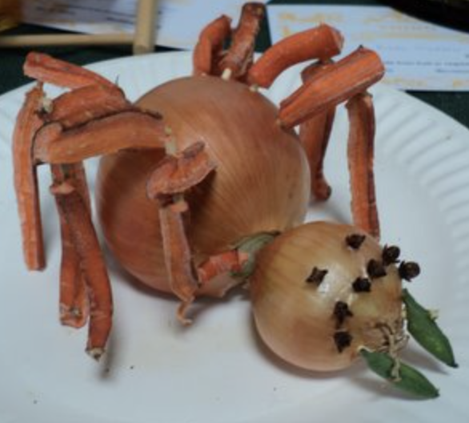
WG EUI September 8, 2023 ‘the onion or the spider’

Slide 2
topics discussed WG 23/03/2023
internationalisation of alliances
onion model of internationalization of European University Alliances
center = alliance
first layer = other alliances
second layer = European Higher Education Area (EHEA)
non-EHEA
position of CLUSTER within the onion?
linking with other alliances (many people other alliances present)?
advocate as policy in EHEA?
relationship with CESAER (new secretary-general)?
use and expand associated partners to create links outside EU?
through universities or through alliances in other continents?

Slide 3
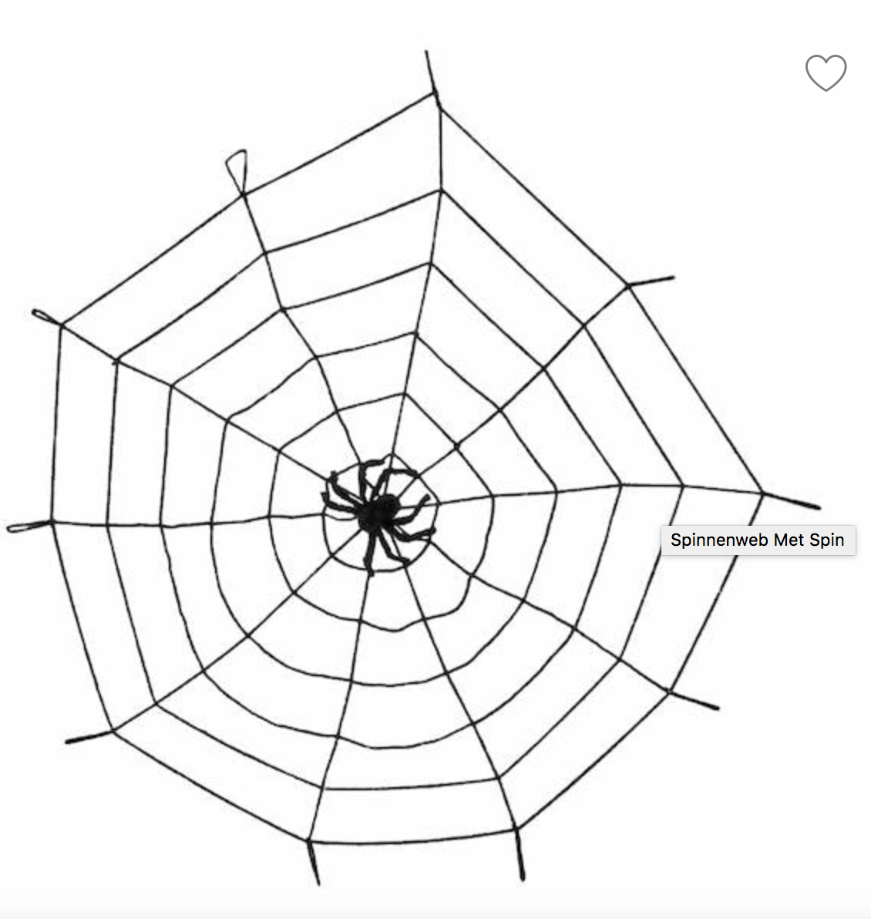
the onion or the spider
…

Slide 4
situation European Alliances
report European Parliament:
‘The European Universities Initiative: first lessons, main challenges and perspectives’ (January 2023)
analysis of the selection procedure
benefits and challenges
too early to assess the impact
current operational model unsustainable (funding)
challenge in finding appropriate governance structures that ensures long-term funding
future developments
need for clear regulatory issues and appropriate organizational form
strengthen connection EUA and ERA to realize impact beyond education
broader opportunities for international collaboration beyond EU

Slide 5
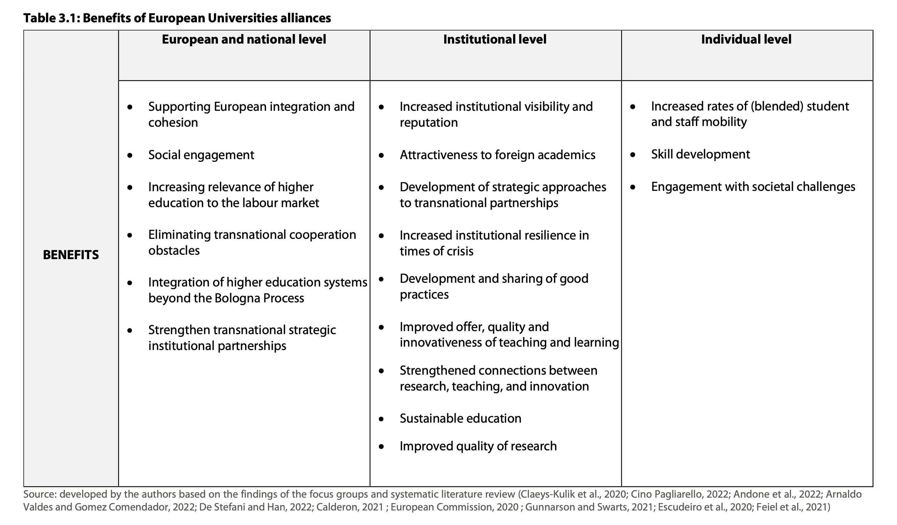
Source: The European Universities Initiative: first lessons, main challenges and perspectives, 2023.

Slide 6
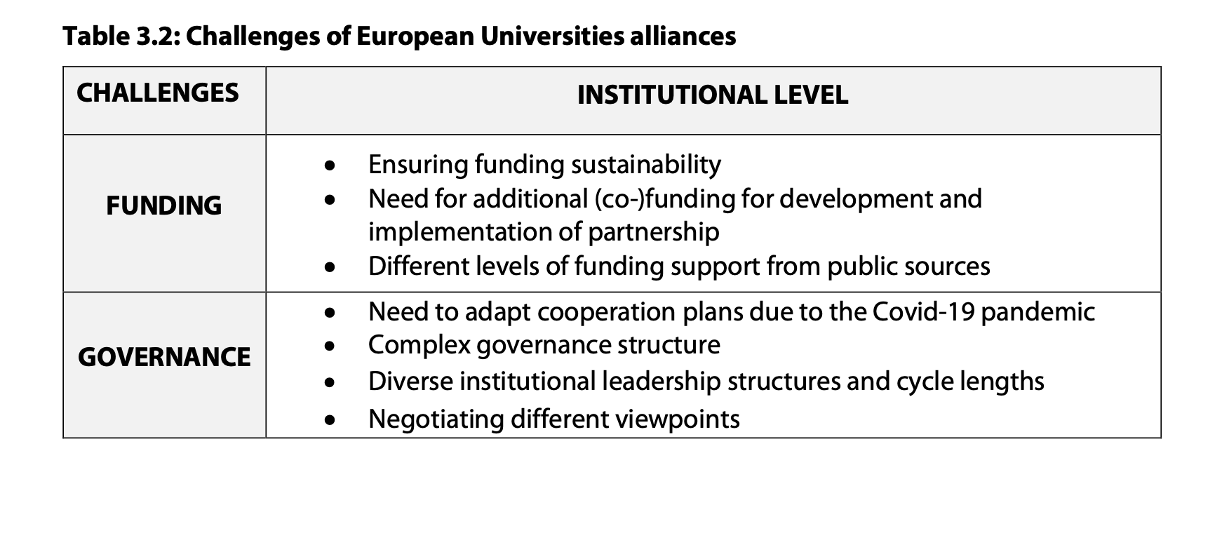
Source: The European Universities Initiative: first lessons, main challenges and perspectives, 2023.

Slide 7
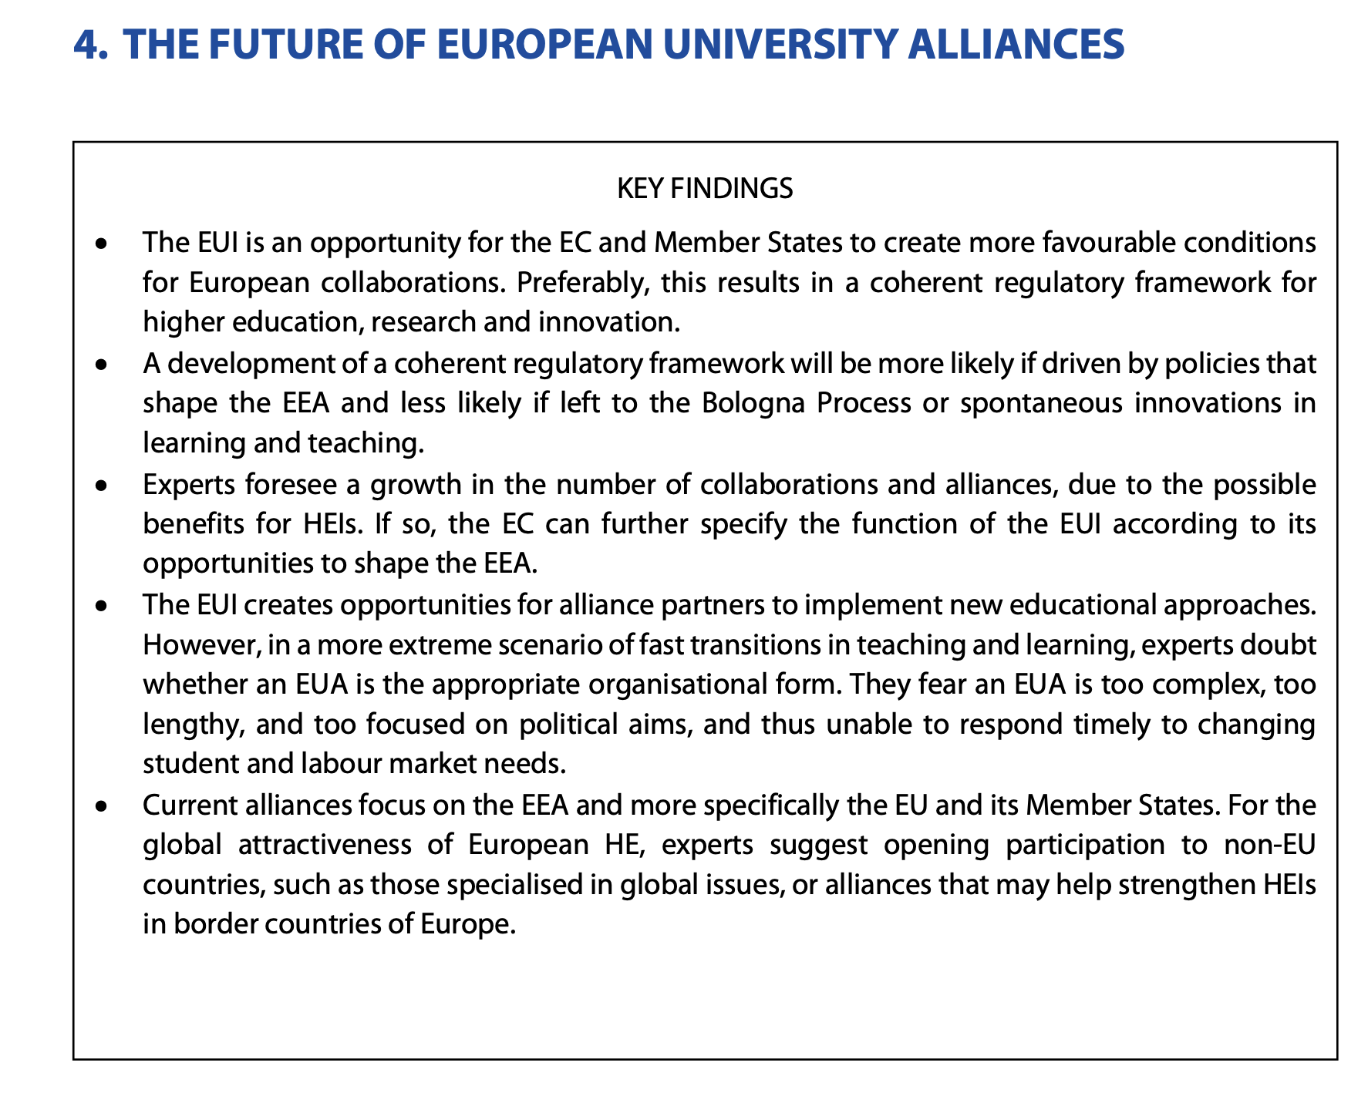
Source: The European Universities Initiative: first lessons, main challenges and perspectives, 2023.

Slide 8
situation CLUSTER
small enough to be flexible, big enough to be important
tradition of collaboration with proven impact
GAST (REDEEM, EUCRITE, INGDIVS, …)
BIP development
…
no long-term funding issues
voluntary basis
no regulatory issues, no governance issues
already proven collaboration beyond EU
Polytechnique Montréal, University of Sao Paulo
focus on Africa since presidency of Grenoble

Slide 9
the onion or the spider
CLUSTER as a spider in the web
move fast and make links without too much governance
try and share
share also best practices from the different alliances
CLUSTER as a pilot lab
virtual mobility -> try-out of BIP
entrepeneurship in engineering education: CSO event Leuven
link with engineering education in Africa -> Erasmus + project in preparation
share best practices with policy making bodies
input white papers CESAER? What works and what doesn’t?
other opportunities?

Slide 10
the onion or the spider
expand the web
link with WG associated partners
use SEEEP partners to reach out to China
other alliances in other continents?
USHEPIA: University science, humanities and engineering partnerships in Africa
ARUA: African Research Universities Alliance
Magelhaes network with focus on Latin-America (exchange of students)
UNIMED
…
Boost student engagement across EUA

Slide 11
discussion

