Slide 1
WG Communication
CLUSTER Steering Committee, Aalto University, September 8th, 2023

Slide 2
Latest Activities
Meeting on September 7th, 2022, 2023
Main discussions on use and production of testimonials
Participants – Andreas Wohnig (CSO), Wieland Craps and Jelle De Borger (KU Leuven), Suvi Lavinto (Aalto), Maria Eugènia López (UPC), Klaus Rümmele (KIT)

Slide 3
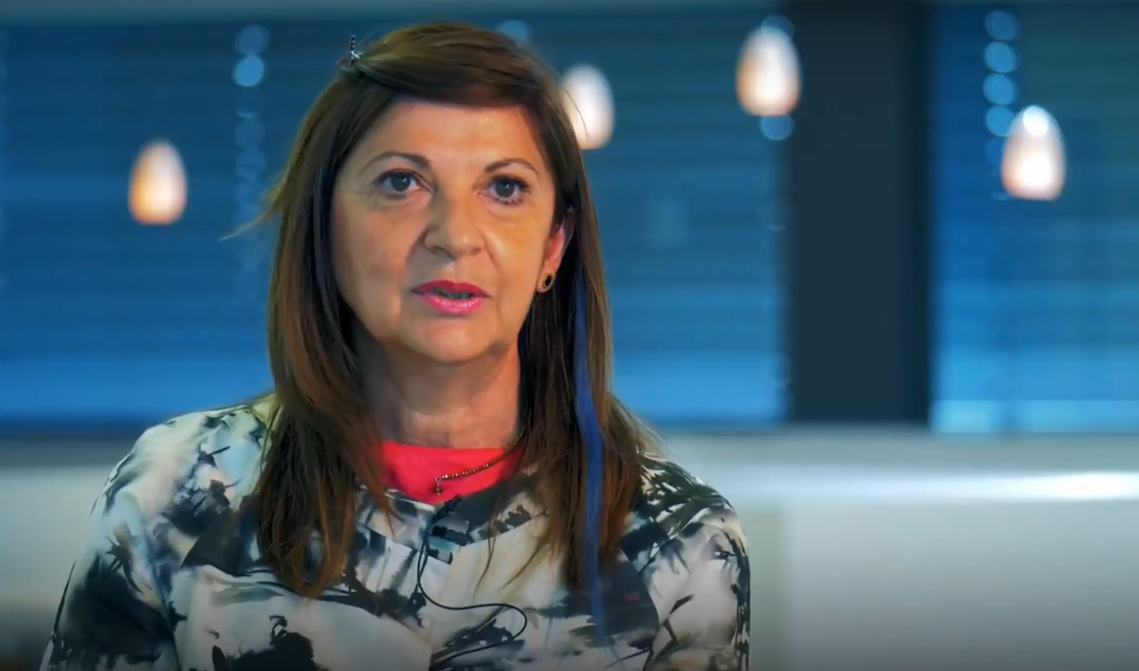
Testimonials
Analysis of good practice examples
Aim: increasing involvement of researchers and students at the member universities in CLUSTER
Format: short video as a teaser linked to a text interview

Slide 4
Guideline
Collection of optional question (experience in CLUSTER, personal benefits, concrete examples …)
Advice on how to communicate authentically
Parameters like running time and language
Hints on how to maintain a certain level of quality
Suggestions on how to include additional information like links to services CLUSTER offers

Slide 5
Next Steps
Collaborative work on the guideline/template draft
Brainstorming at the meeting at Aalto University
Guideline for Unite! Experience Interviews as a pattern
Deadline in November
Production of a pilot to be shown at the SC/GA in Leuven in April 24
Completion of the contact person list for communication

