Slide 1
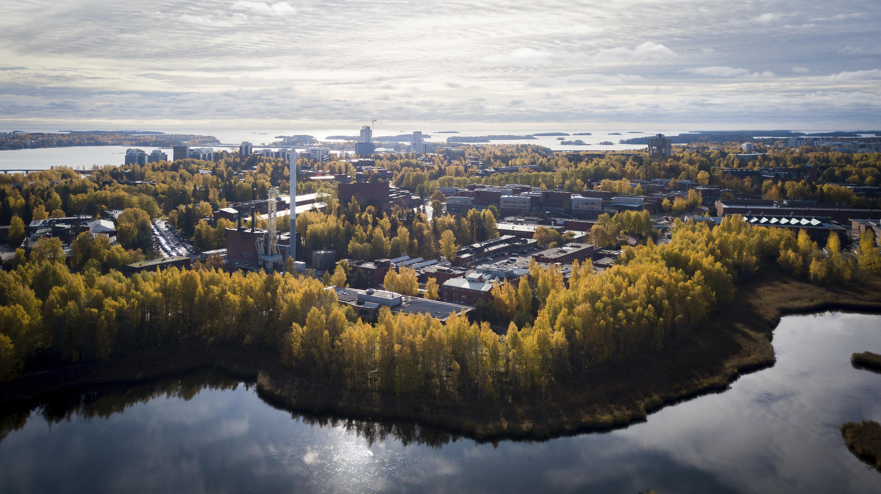

Aalto University
Shaping a sustainable future
Petri Suomala
Vice President, education
8 September 2023

Slide 2


Merger of three leading Finnish universities
Helsinki University
of Technology
1849
Aalto
University
University of Art
and Design Helsinki
1871
2010
1911
Helsinki School
of Economics
Founders:
State of Finland
Confederation of Finnish Industries
TT Foundation
Technology Industries of Finland
Technology Industries of Finland Centennial Foundation
Academic Engineers and Architects in Finland TEK
Foundation for Economic Education
Finnish Business School Graduates

Slide 3
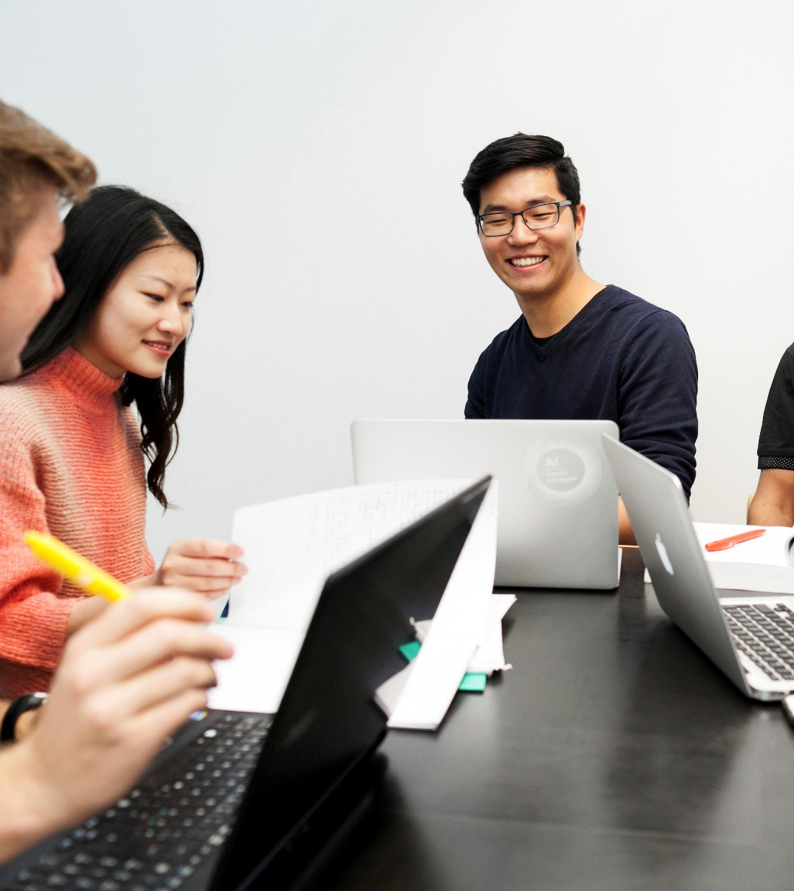
Our community in numbers
13 000
full-time equivalent degree students
Each year our students earn about
200 doctoral degrees,
1 900 master’s degrees,
1 500 bachelor’s degrees and
300 MBA and EMBA certificates.
​
​
A staff of more than 4 000,
of which 400 are
professors. Share of international academic faculty is 48%.

Slide 4
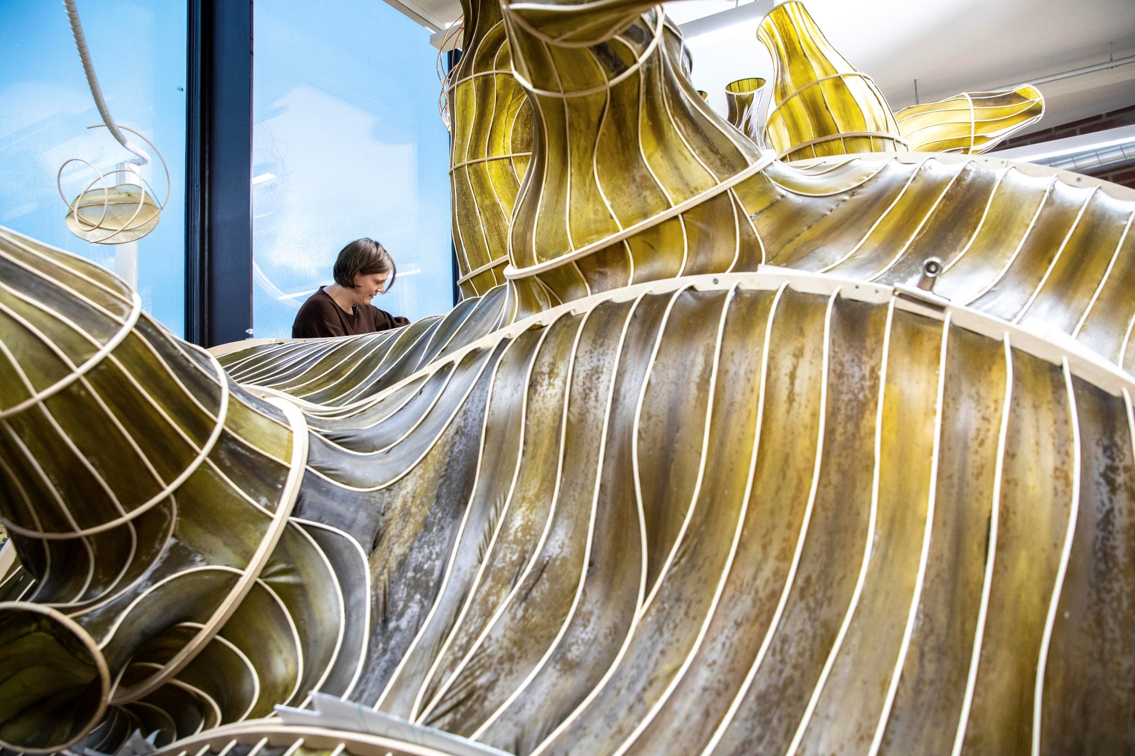
Our purpose: Shaping a sustainable future
​Aalto University is founded on high-quality research, education, impact as well as shared values of responsibility, courage and collaboration. ​
We solve global challenges by bringing talent together across science, art, technology, and business. ​

Slide 5
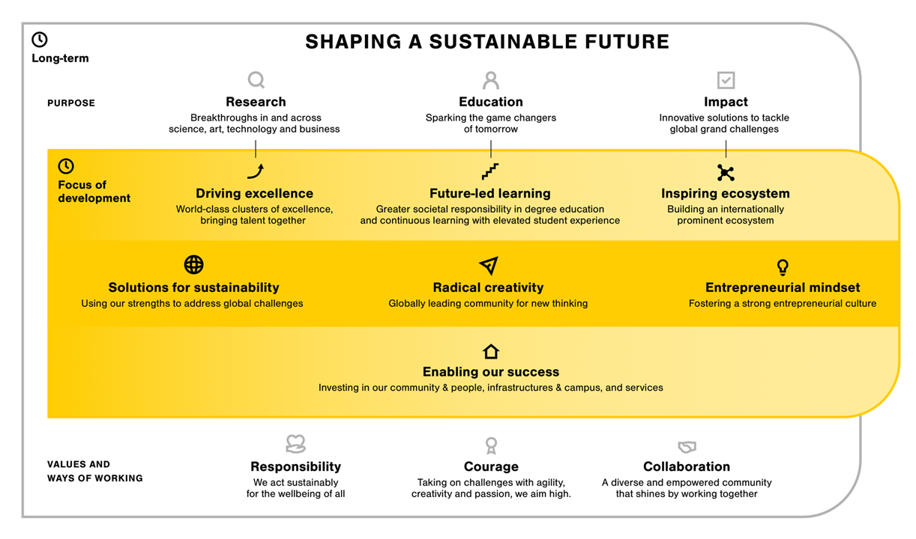

Slide 6
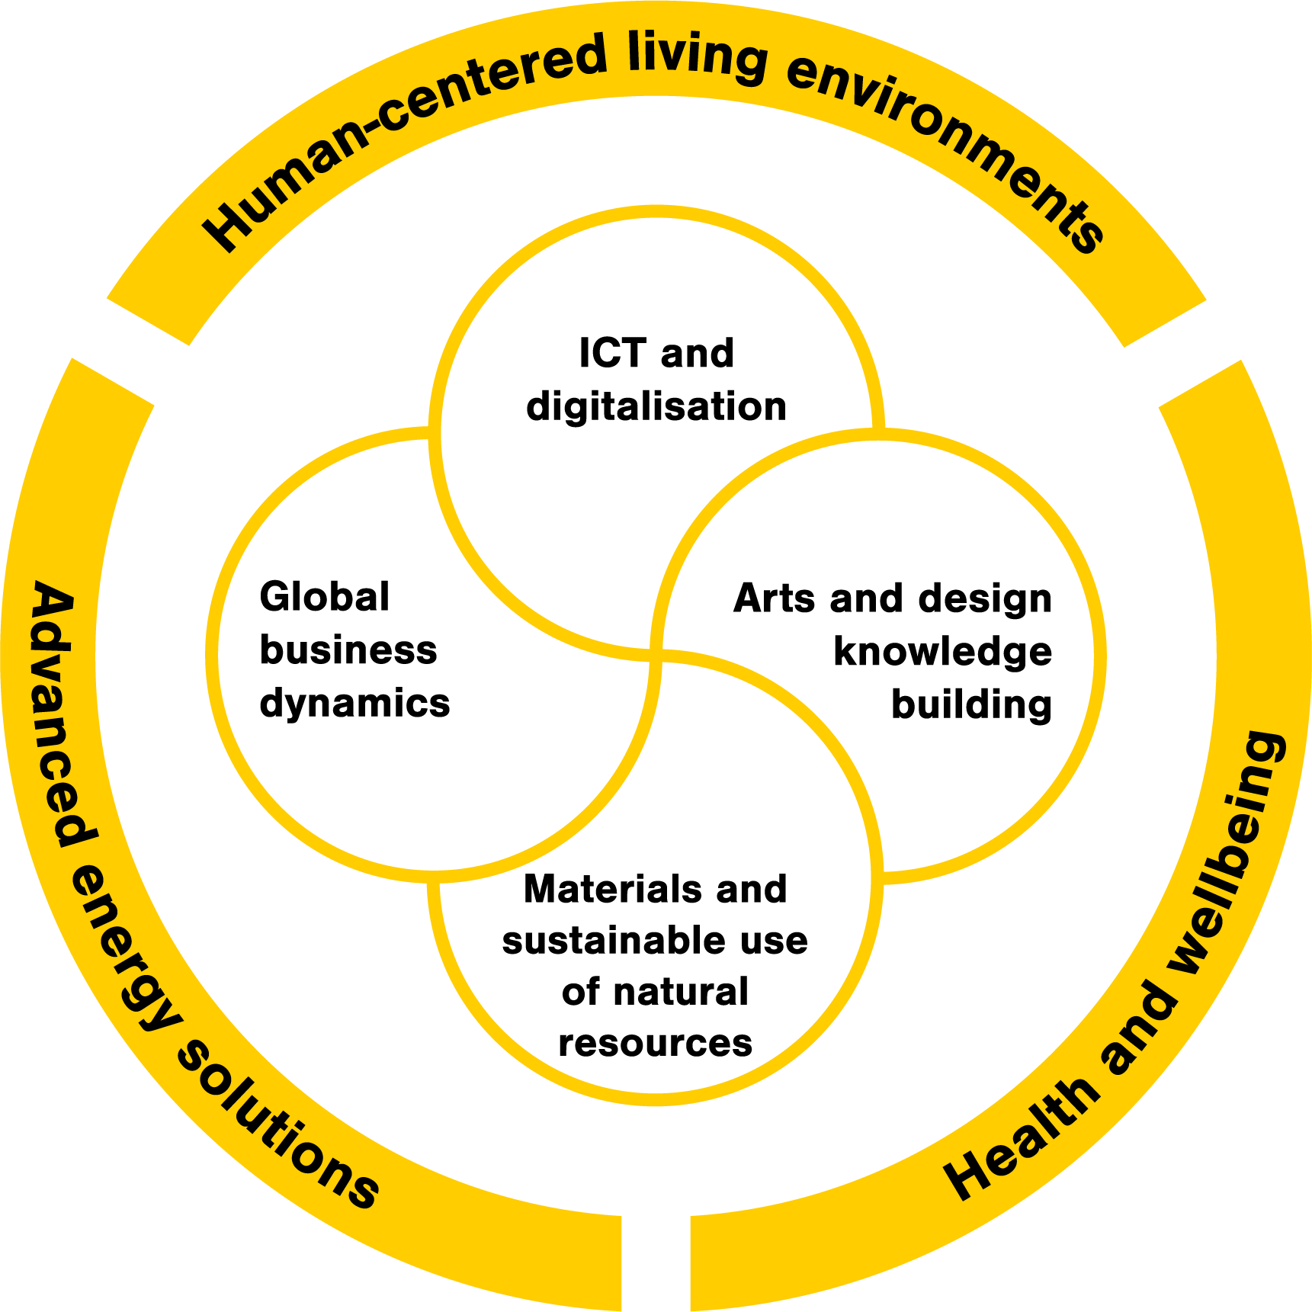

Excellence in all key research areas
ICT and digitalisation
Human-centred living
environments
ShanghaiRanking:
Telecommunication engineering 51-75 (2021: 40)
Computer science & engineering 51–75 (2021: 51–75)
US News: Computer science 71 (2021: 68)
QS: Architecture & built environments 48 (2022: 42)
ShanghaiRanking:
Marine/Ocean Engineering 21 (2021: 39)
Arts and design
knowledge building
Health and wellbeing
QS: Art & design 6 (2022: 6)
ShanghaiRanking:
Medical technology 201-300 (2021: 101–150)
Materials and sustainable
use of natural resources
QS: Materials sciences 80 (2022: 95)
US News: Polymer Science 65 (2021: 54)
Advanced energy solutions
ShanghaiRanking:
Electrical & electronic engineering 76-100 (2021: 101-150)
QS: Electrical & electronic engineering 104 (2022: 97)
US News: Electrical & electronic engineering 97 (2021: 92)
Global business dynamics
ShanghaiRanking:
Business administration 24 (2021: 25)
Management 38 (2021: 31)
THE: Most international universities in the world 47 (2021: 40)
QS: Top 50 under 50 (young universities) 9 (2020: 9)
Leiden: University-industry collaboration 22 (2021: 21)

Slide 7
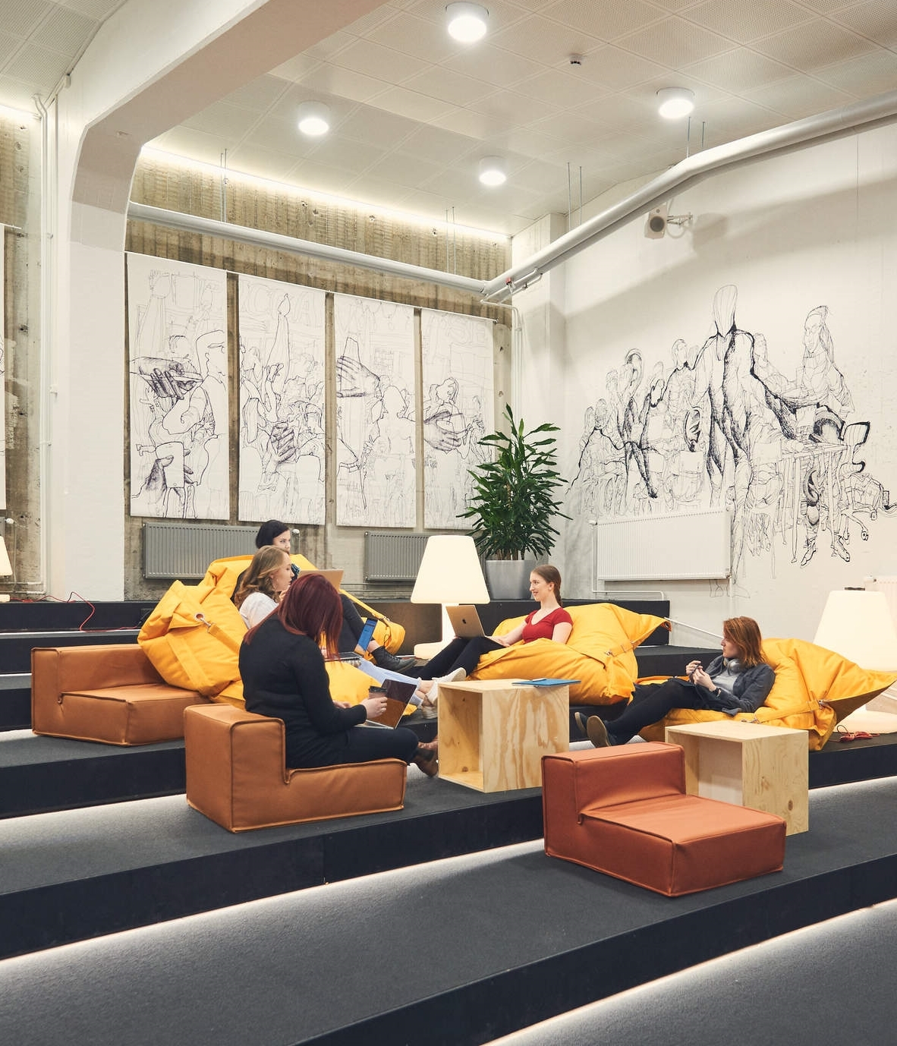

We spark the game changers
of tomorrow
Education
Focus of development: Future-led learning
We take greater societal responsibility in degree education and continuous learning, in and across our key areas. We elevate student experience and quality of learning.
Actions: Renewing educational offering, developing our digital and engaged learning environment, integrating sustainability and multidisciplinary studies into programmes, advancing learning-centricity, focusing on holistic wellbeing
lifewidelearning.aalto.fi

Slide 8
Aalto innovation ecosystem highlights
(yearly numbers)
About
100
companies are founded every year in our ecosystem
One of the
top-3
University based business accelerators in the world (UBI, 2022)
Number of commissioned projects with companies
200
150
number of invention disclosures
25 - 30
number of technology transfers

Slide 9
Shaping a sustainable future.

