Slide 1
CLUSTER General Assembly 2024
Hosted by KU Leuven
10/04/2024 – 12/04/2024

Slide 2
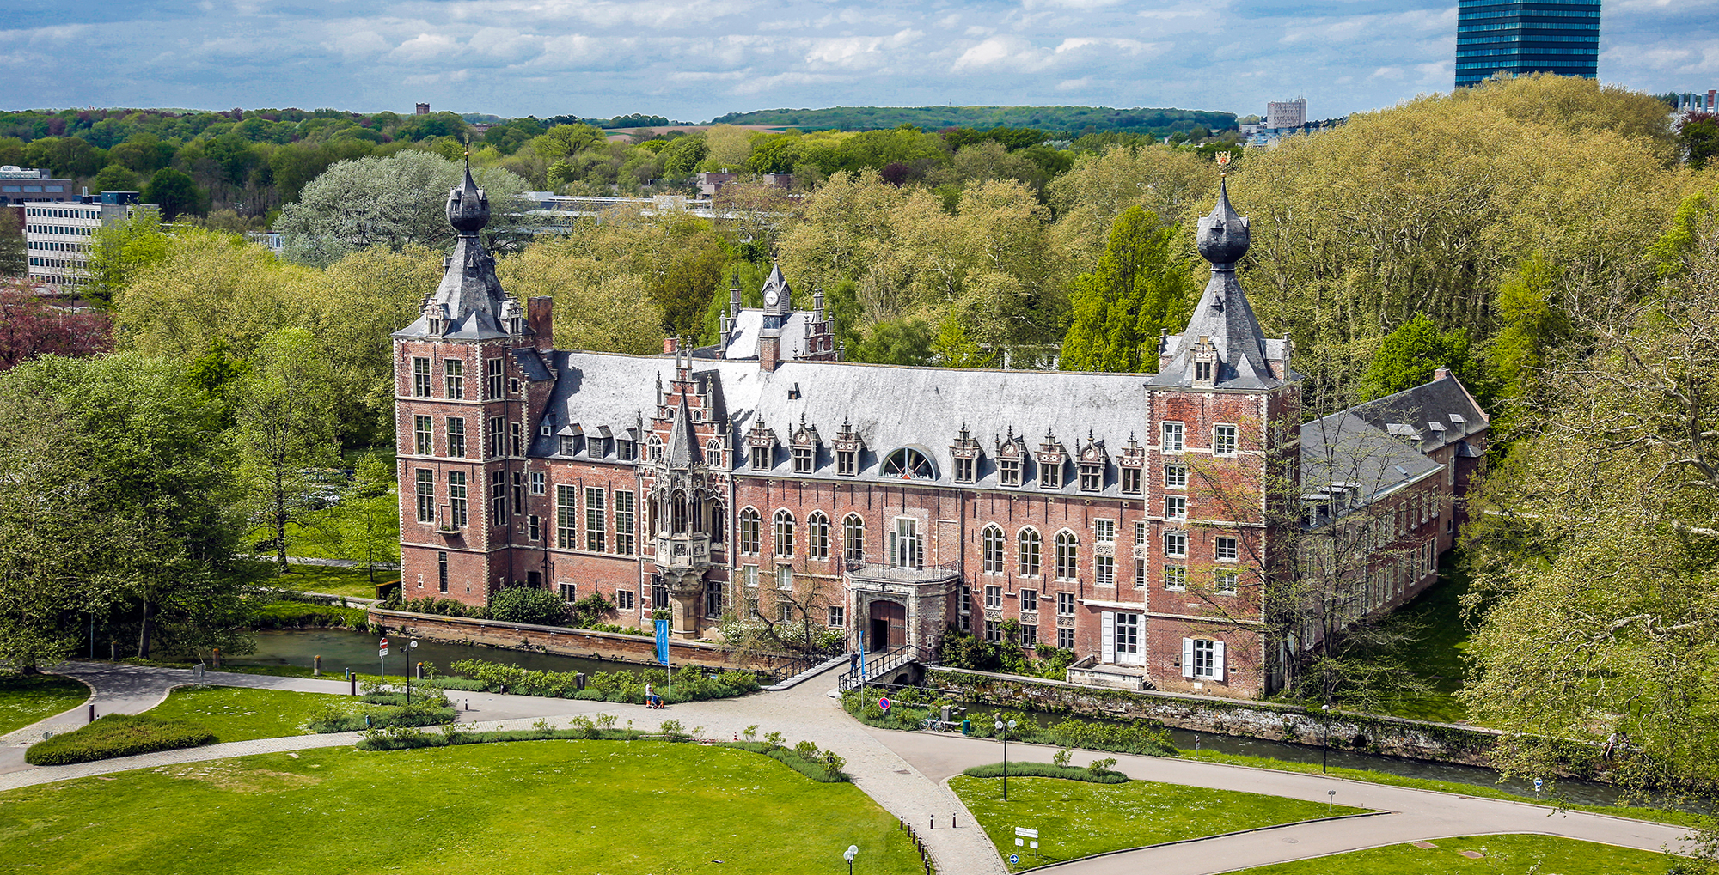
Wednesday 10/04

Slide 3
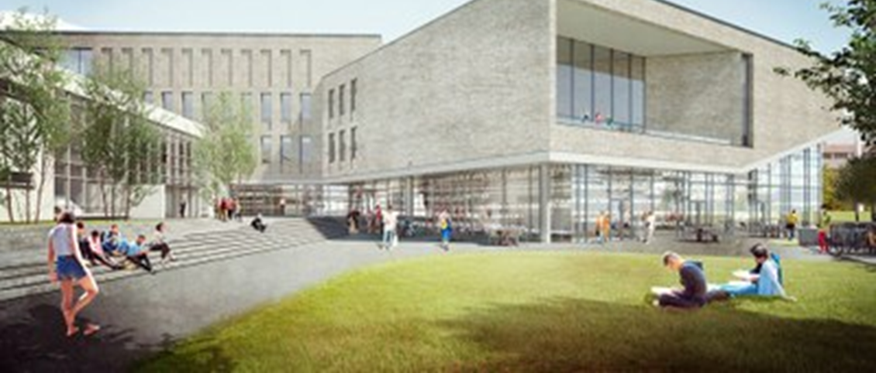
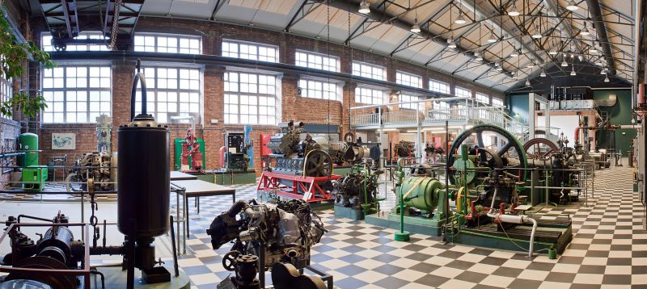
Meetings Reception
Notes:
Meetings will be held in the Quadrivium which was constructed in 2020. It is equiped with an auditorium large enough for 600 people, mulitfunctional seminar rooms and collaborative learning areas.
The reception will take place in the Machineroom near Arenberg Castle

Slide 4
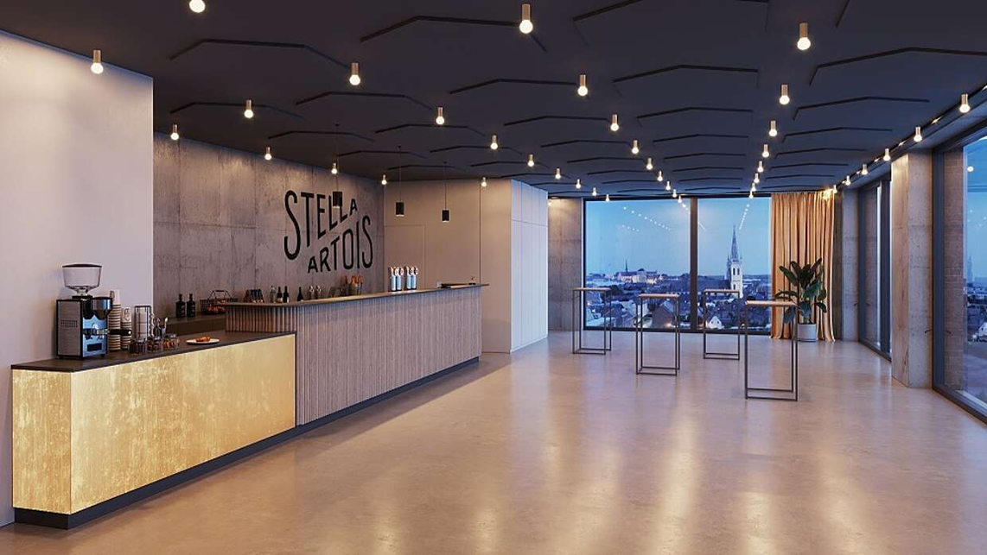
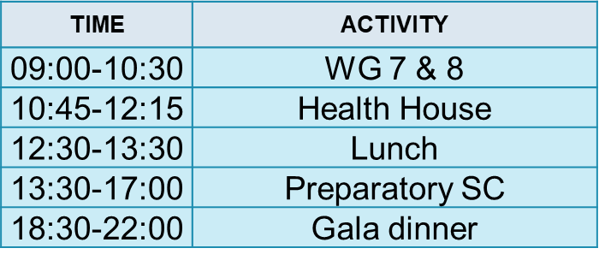
Thursday 11/04

Slide 5
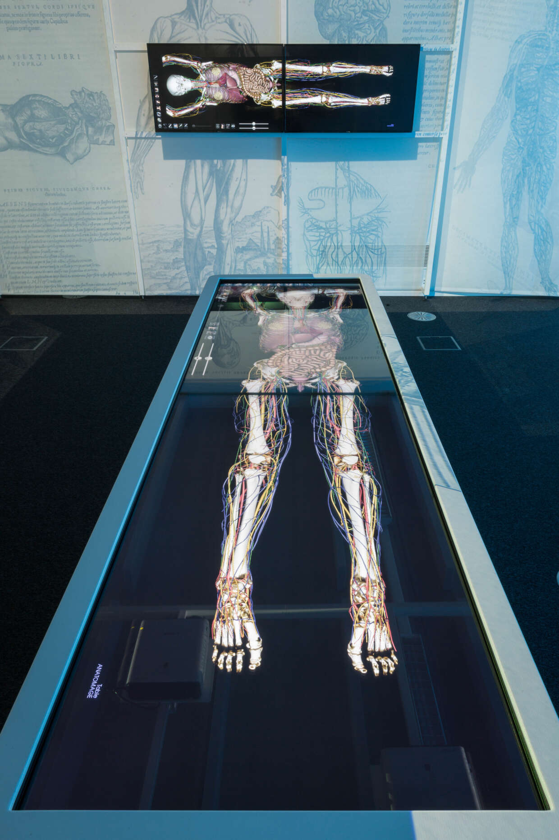
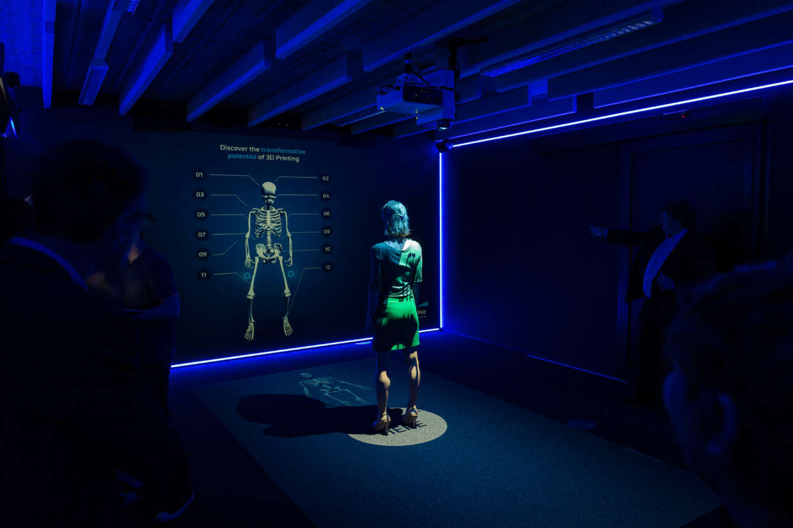
Health House
Notes:
Come and experience first-hand the future of medicine and healthcare with your team.
Always wanted a chance to play the surgeon and perform an operation on a digital human body? Or to examine the brain of an epilepsy patient via virtual reality? Or would you rather find out how 3D-printed implants are going to enormously improve our quality of life? You can discover this and much more in a unique and interactive way at Health House.
Looking for a place to organize a launch event, workshop, co-creation session or teambuilding? In addition to their experience centre, there are 3 state-of-the-art meeting- and conference rooms available to cover every type of event.

Slide 6
De Hoorn
Notes:
De Hoorn is the old Stella brewery dating back to the early 18th century. In recent years the building was repurposed and transformed to it’s current state.
It has a restaurant, living quarters (mostly occupied by expats), meeting rooms and workspaces.
(Also it still has the old copper kettles)

Slide 7
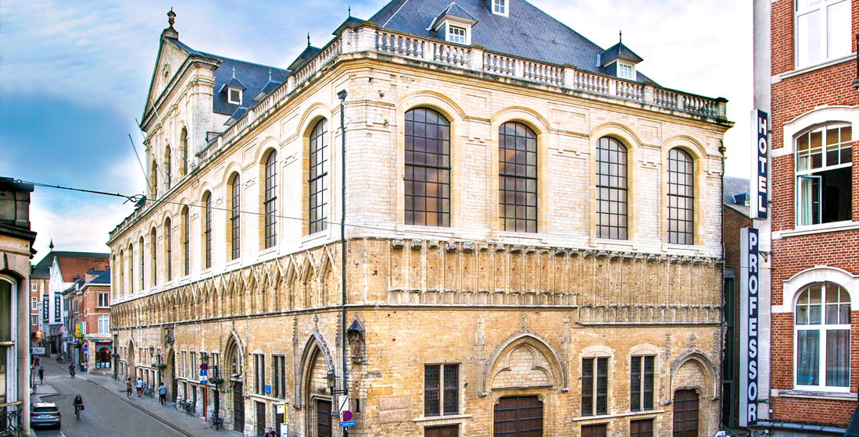
Friday 12/04

Slide 8
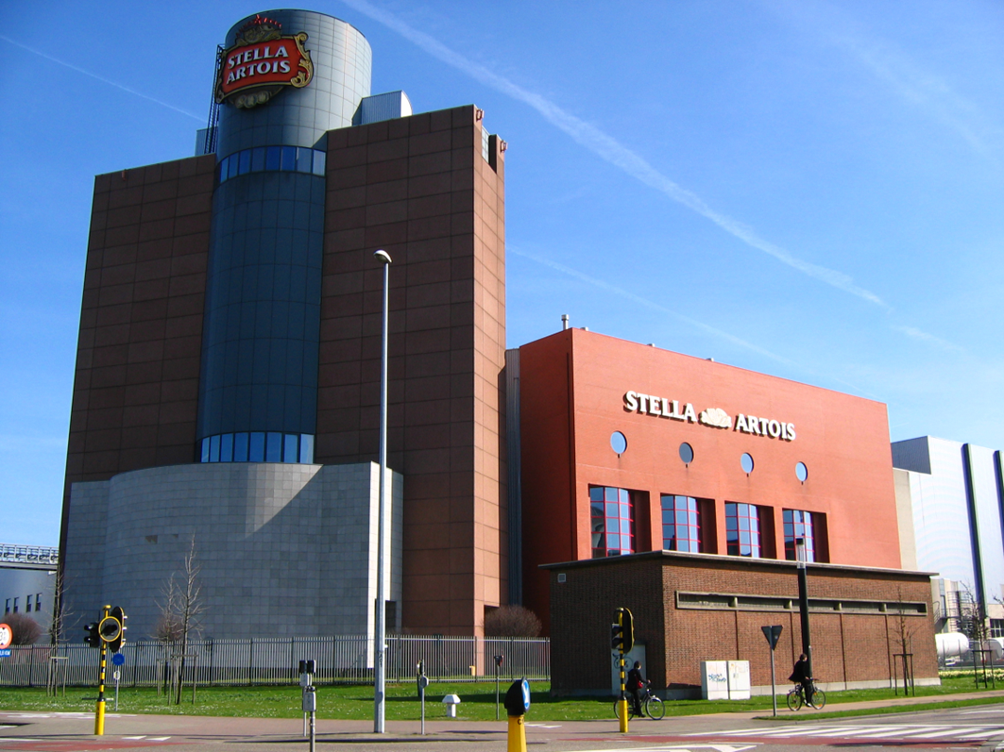
Stella (optional)

Slide 9
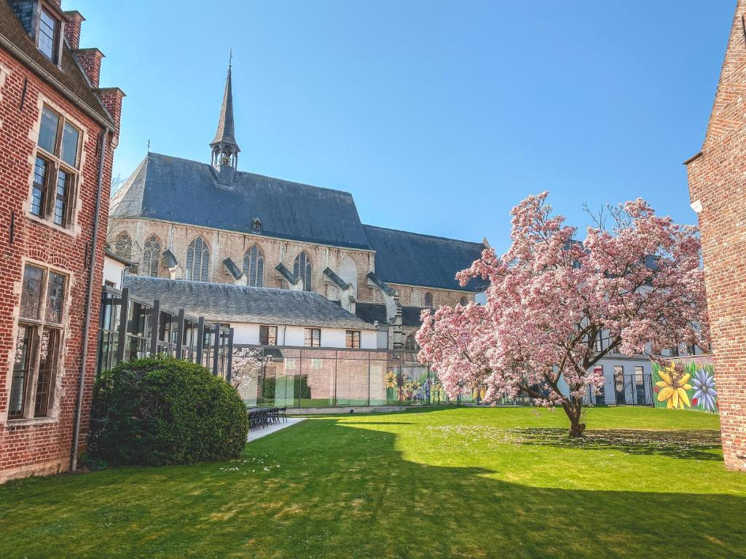
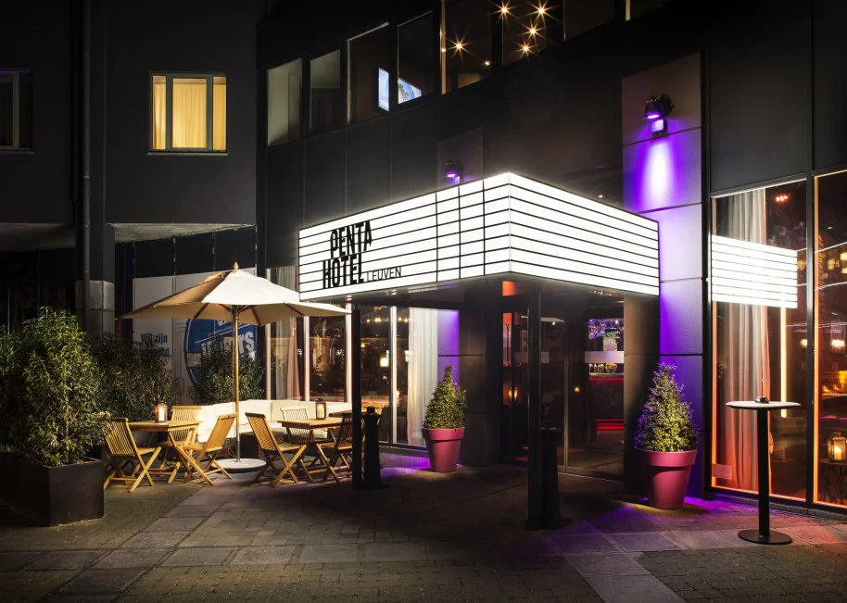
Hotel Suggestions
Martin’s Klooster Hotel
Pentahotel
Notes:
https://www.martinshotels.com/en/page/martins-klooster/martins-klooster-4-hotel-louvain-official-website.11057.html?gclid=EAIaIQobChMIy6_S28rAgAMV3JSDBx3vuAcxEAAYASAAEgJIu_D_BwE#backlink:actu-271
https://www.pentahotels.com/hotels/belgium/leuven?gclid=EAIaIQobChMI_9_d-MrAgAMVTOR3Ch0iYwMVEAAYASAAEgKkJ_D_BwE&gclsrc=aw.ds

Slide 10
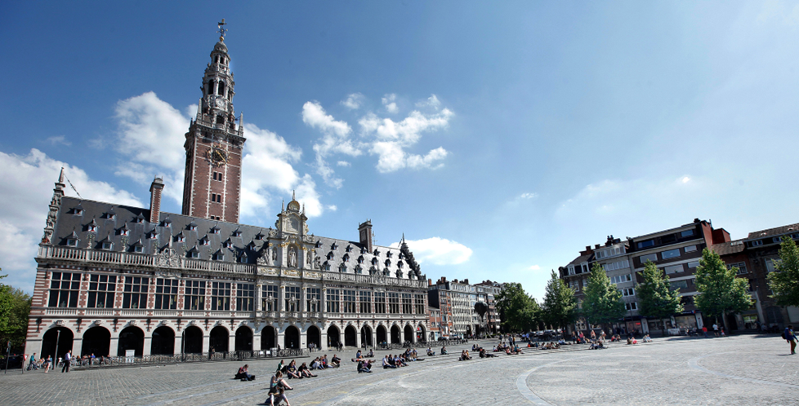
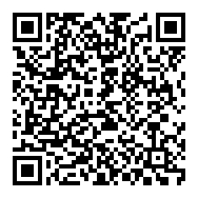
OVERVIEW
DAY | TIME | ACTIVITY
Wednesday 10/04/2024 | 09:00-10:30 | WG 1 & 2
 | 10:30-12:00 | WG 3 & 4
 |  | Campus Tour
 | 12:00-13:00 | Lunch
 | 13:00-14:30 | WG 5 & 6
 | 14:30-15:30 | Arenberg castle Tour
 | 16:00-18:00 | CLUSTER - CESAER Meeting
 | 18:00-20:30 | Networking Reception
Thursday 11/04/2024 | 09:00-10:30 | WG 7 & 8
 | 10:45-12:15 | Health House
 | 12:30-13:30 | Lunch
 | 13:30-17:00 | Preparatory SC
 | 18:30-22:00 | Gala dinner
Friday 12/04/2024 | 09:00-13:00 | General Assembly
 | 13:00-14:30 | Lunch
 | 15:00-17:00 | Brewery visit - Stella (optional)
Save The Date
Notes:
3 days
Starts on Wednesday 10/04/2024 @09:00
Ends on Friday 12/04/2024 @14:30 OR @17:00

