Slide 1
CLUSTER Symposium
Entrepreneurship in the Engineering Education

Slide 2
Background
Joint event:
CLUSTER Student Organisation
WG Entrepreneurship
WG CLUSTER & Africa
Broad target audience:
Students
Professors
Academic Staff
Notes:
Primarily Master and PhD students, but BA student are also welcome
Academic staff includes administrative personnel

Slide 3
Concept
We wish to inspire and stimulate the entrepreneurial mindset of the participants. Share good practises so we can learn from each other and see where improvement is possible.
When: Friday 14/04 – Saturday 15/04
Where: KU Leuven
Notes:
It will be a in person event. Some aspects will be recorded and might be public after the event.

Slide 4
Programme
Friday 14/04
Opening
Keynote speakers
Humasol
Reception
Saturday 15/04
Share good practices
Lecture on Serendipity
Interactive Challenge
Presentation of the results
Notes:
Keynote:
Talk about their experience with entrepreneurship in their education programme (the good and the bad), how they where stimulated/the catalyst that resulted in starting their on businesses and/or organisations
Fried Vancraen: Founder & CEO of Materialise
A company that aims to innovate product development that results in a better world, through their software and hardware infrastructure and in-depth knowledge of additive manufacturing.
Katrien Herdewyn: Founder of Elegnano
A business that offers elegant shoes for men and women. Elegnano is literally, and figuratively a fusion of elegance and nanotechnology. Nanotechnology is for example integrated at the level of leather technology to improve the quality, comfort, and durability of the collections.
Wim Farasyn: Founder of BEST Leuven & co-founder of Lanark
Digital Supply Chain Engineers develop and continuously re-engineer the supply chains of the future. They aim for turning traditional cost centres into profit drivers by bridging operations and IT, navigating exciting new technological possibilities.
The organisation Humasol will present who they are and what they do.
Humasol is a non-profit organization that aims to make renewable energy, water and sustainable technology accessible to everyone.
They will present the Africa-oriented subject for the interactive challenge
Good practises:
Which CLUSTER members will present?
Grenoble – Christel Tessier
Politecnico – Francesso Serraino
Aalto – Kalle Airo
KIT – Alexander Tittel
An audience broader then WG/CLUSTER members and will include students, academic staff and professor who are not in direct contact with CLUSTER. The focus will be on the ‘sharing of good practices’ rater then an in depth exchange.
Challenge:
Groups of 4-5 people
3,5H time
A process and content coach will be present to assist the different teams.
The groups will present their solutions at the end of the day

Slide 5
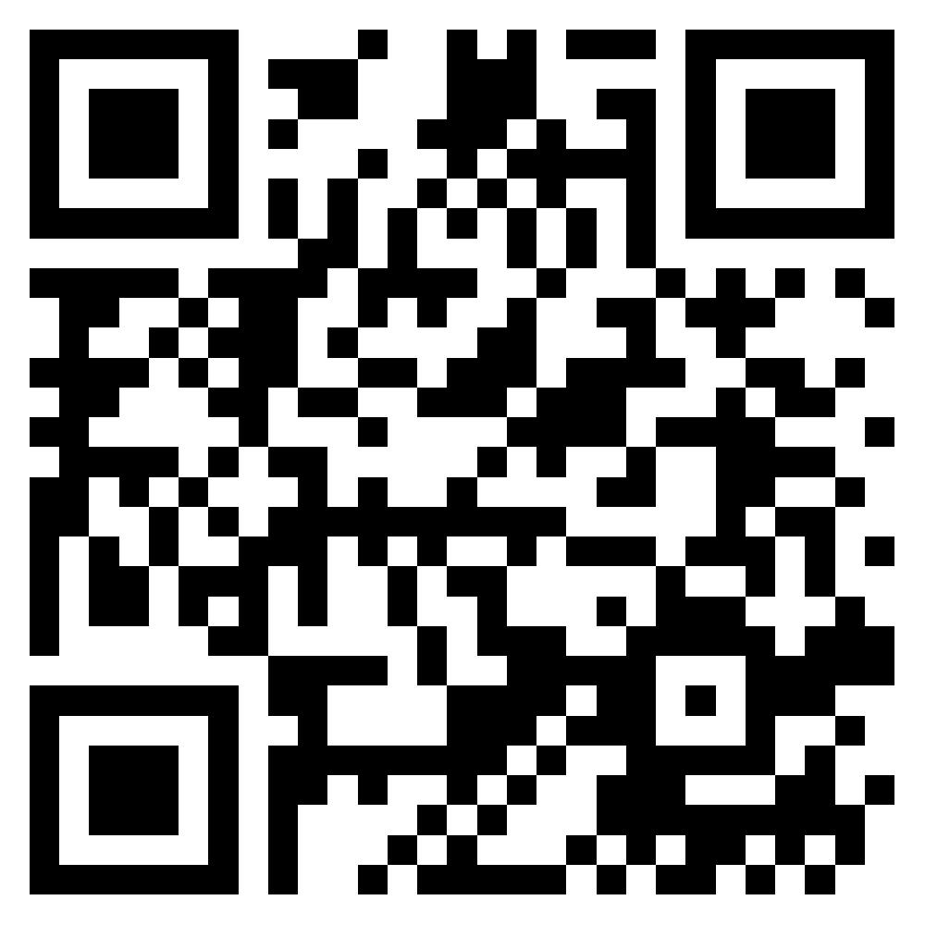
Registration (deadline = 10th of April)

