Slide 1
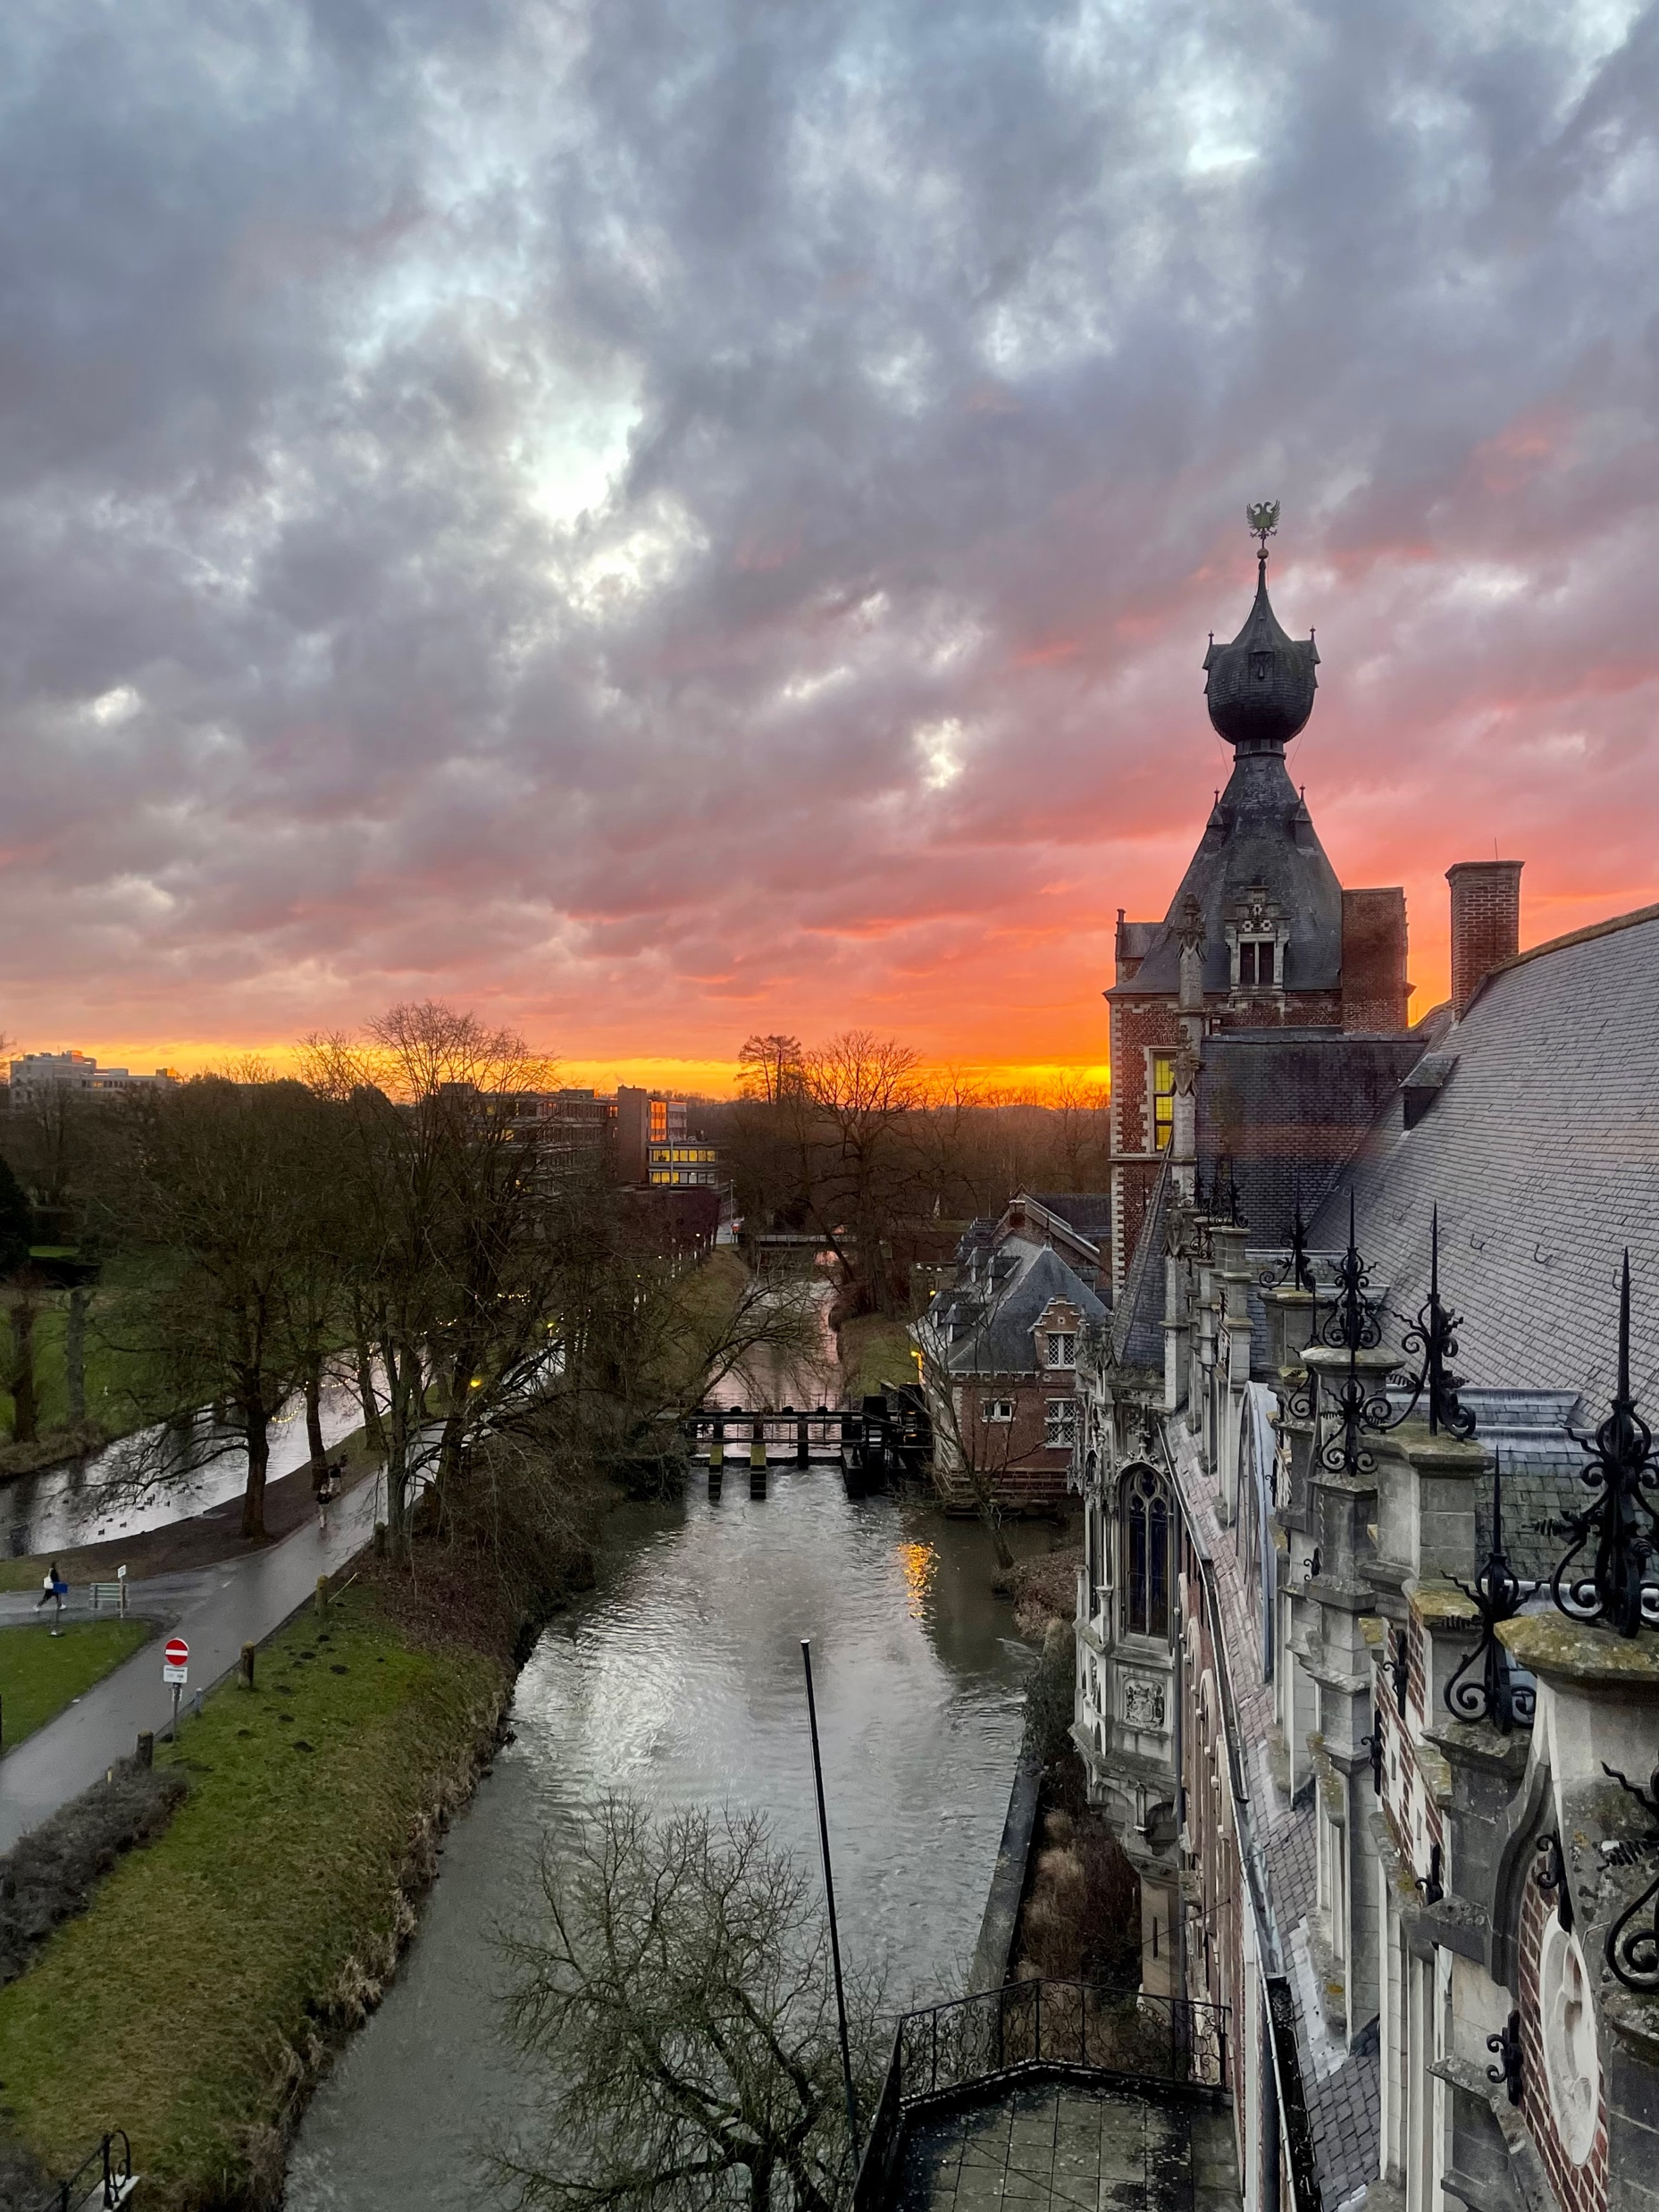
European University Initiatives ‘future of CLUSTER’ SC-Torino 09/22 Peter Van Puyvelde dean Faculty of Engineering Science KU Leuven

Slide 2
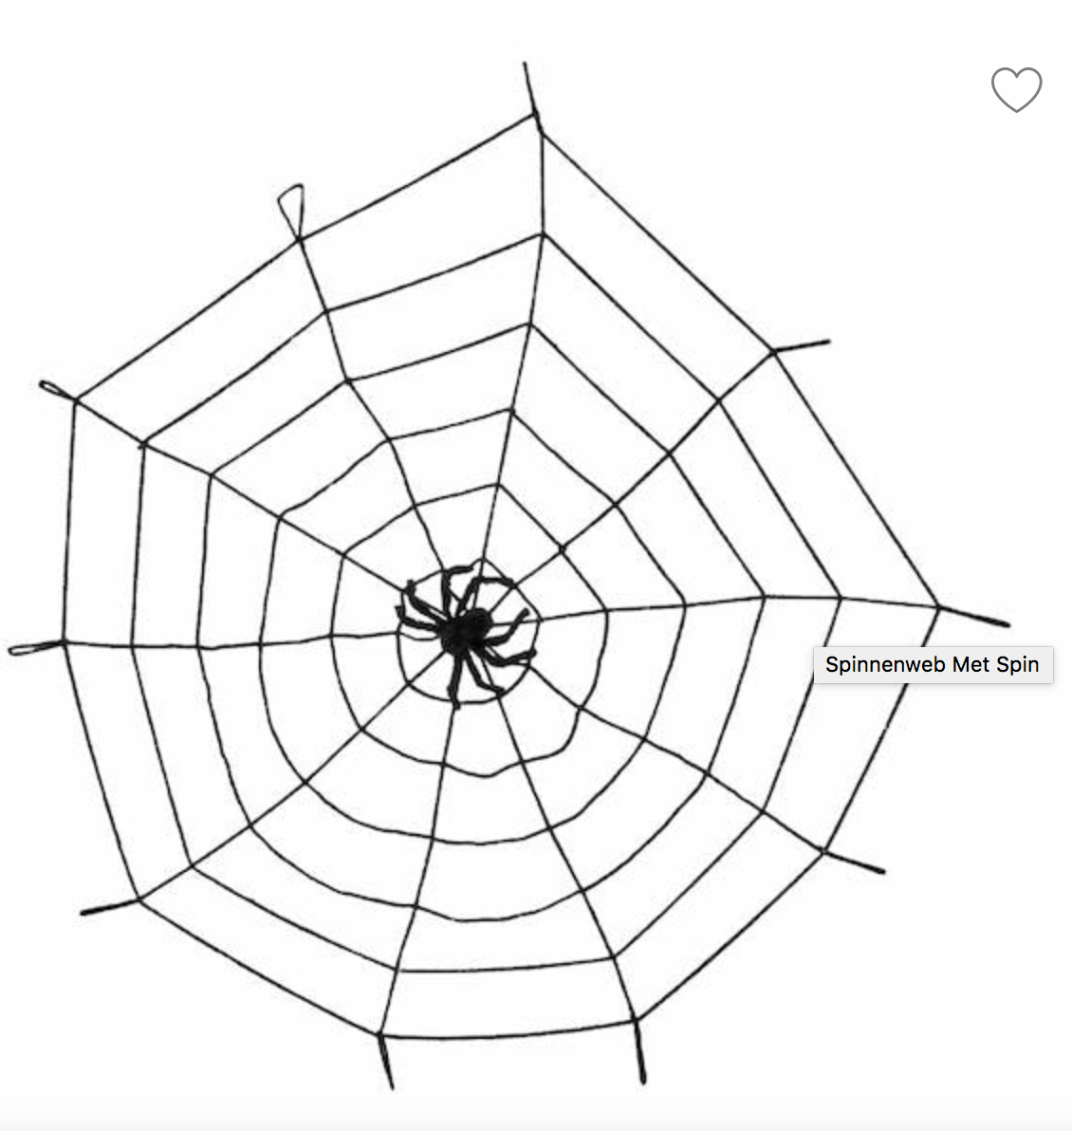
spider in the web
…

Slide 3
spider in the web
what is common?
we are engineering oriented
we work on common topics
virtual mobility
entrepeneurship
link with Africa
microcredentials
Life Long Learning
use CLUSTER as pilot lab
‘small enough to be flexible, big enough to be important’
sharing practices is nice and necessary
trying out things is probably nicer

Slide 4
spider in the web
‘small enough to be flexible, big enough to be important’
discussion points
CLUSTER as pilot lab
what experiment?
GAST
SEEP
mobility
communication and branding
governance and way of working
EUI
sustainable development
Africa
entrepeneurship
associated partners
Cluster Student Organisation
many ‘experiments’ with
limited resources
CHOICES!!!
CONCRETE DELIVERABLES

Slide 5
spider in the web
‘small enough to be flexible, big enough to be important’
clustering working groups
GAST – Africa – entrepreneurship
virtual mobility: on-line versus hands-on
BIP’s with selected partners -> CLUSTER has privileged position
Erasmus+
CSO workshop entrepreneurship with invited African students
CLUSTER can do it
on-line project based
students with different nationalities/cultures that work together
how to bring this in our curricula?
CLUSTER can do it

Slide 6
spider in the web
‘small enough to be flexible, big enough to be important’
CLUSTER as a laboratory?
importance of bottom-up initiatives. (not necessarily related to priorities presidency)
small scale experiments to learn from (in positive or negative manner)
importance of the scale of the experiment
can also lead to shared experiences or to results important enough for the alliances
seed money for initiatives coming from working groups to stimulate experiments (eventually in a cofinance-model)

